Slide 1
FHDA CCD MIS Financial Aid Data Cleanup Methods & Procedures
Lourdes del Rio-Parent, PhD
Senior Research Analyst
Foothill-De Anza CCD
March 2024

Slide 2
Goal and Objectives
Provide an overview of methods and procedures used for the data cleanup and submission of the MIS Financial Aid Reports (SF, FA) at the FHDA CCD.
Identify main data sources
Illustrate main steps of the data flow for the data cleanup and submission
Explain the use of a lookup table (crosswalk of FHDA-MIS codes) to facilitate data cleanup and submission
Show the use of technologies (e.g., SQL views, SAS) for data cleanup and submission
Explain the purpose of the FHDA IRP MIS Financial Aid Report webpage in the data cleanup process

Slide 3
FHDA MIS SF (Financial Aid Applicant) Data Sources
FAFSA
California College Promise Grant Application (when FAFSA is not available)
Banner
MIS SF
Notes:
The main data source for MIS SF is the FAFSA (Free Application for Federal Student Aid). When FAFSA data is not available, data from the CCPGA (California College Promise Grant Application) is used instead. Data from FAFSA and CCPGA are stored in Banner and extracted for the MIS SF report.

Slide 4
FHDA MIS SF-Applicant Data Flow
Banner FAFSA/CCPG
SQL
SF Views
SAS
MIS SF
Notes:
Data in Banner from FAFSA (RCRAPP# tables) and CCPG (RVRSAAP) applications are extracted using SQL views. SAS (computer programming language) is used to read files, process the data (gives priority to FAFSA over CCPD data), and then create the MIS SF file. Data errors during the submission of MIS SF may require the submission of the SI Update report (update student IDs), changes in Banner, or edits in SAS—deleting records for students with no application; inserting values to the report when the Banner system does not allow updates to the data field.

Slide 5
FHDA MIS FA (Financial Award) Data Sources
Banner-Student Account
FHDA-MIS Award Code Crosswalk
MIS FA
Banner- Financial Aid
Notes:
Banner-student account is the data source for all tuition fee waivers (CCPGs) and Banner-financial aid is the source for all other financial awards. The FHDA-MIS award code crosswalk is what determines what data will be submitted and how FHDA detail and fund codes will translate to MIS codes. Financial aid directors must review this lookup table and confirm that the information is correct prior submission date. A copy of the tables is available at https://research.fhda.edu/mis_reports/mis_financial_aid/ (see heading, CROSSWALK BETWEEN FHDA AND MIS AWARD CODES).

Slide 6
FHDA MIS FA-Awards, Cleanup Data Flow
Update FHDA-MIS code crosswalk
Create MIS SF, FA views
Run and post preliminary figures report
Data in FHDA-MIS code crosswalk is reviewed and confirmed by financial aid directors
Data in preliminary reports is reviewed and confirmed by financial aid directors prior submission

Slide 7
FHDA MIS FA-Awards Data Cleanup: Crosswalk of FHDA and MIS Award Codes
FHDA-MIS Award Codes Lookup Table
Crosswalk between FHDA and MIS award codes
Provides description for FHDA and MIS codes
Helps translate FHDA detail codes into a MIS codes by taking into account the type and source of the code
Identifies Banner data sources and redundancies (e.g., data that shows in both student account and financial aid tables)
Identifies dummy codes (not to be reported in MIS)
Posted at the FHDA IRP MIS Reports webpage:
http://research.fhda.edu/mis_reports/mis_financial_aid/
Notes:
The FHDA-MIS Award Codes lookup table (MIS_FA_FHDA_MIS_CODE) is an actual SQL table that is used by the FHDA MIS FA report to extract data from Banner and process it accordingly. The table is also used to identify redundancies and data that is not reported. Prior to submission, this table is updated based on feedback from data custodians. A copy of the most recent table is available at https://research.fhda.edu/mis_reports/mis_financial_aid/.

Slide 8
FHDA MIS FA-Awards, Preliminary Figures
The preliminary figures report is an Excel document that allows financial aid directors to review student headcount and total award amount data by FHDA/MIS code for the reporting and prior academic year. The document includes the following worksheets:
Stud Headcount & Total Award Amount
[College] CCPG_BOG
[College] GRANTS
[College] LOAN
[College] SCHOL
[College] WORK
Missing awards
Notes:
The worksheet “Stud Headcount & Total Award Amount” shows the student headcount at the college level for the reporting and prior years. Data in this worksheet also shows total headcount and award amounts by MIS award type (CCPG/BOG/Fee Waiver, Grants, Loans, Scholarships, Work Study) for the reporting and previous academic year. “Missing awards” identify active MIS FA codes with no headcount or award data for the reporting year (i.e., to help identify data not yet in the system or miscoded in the FHDA-MIS code crosswalk table).

Slide 9
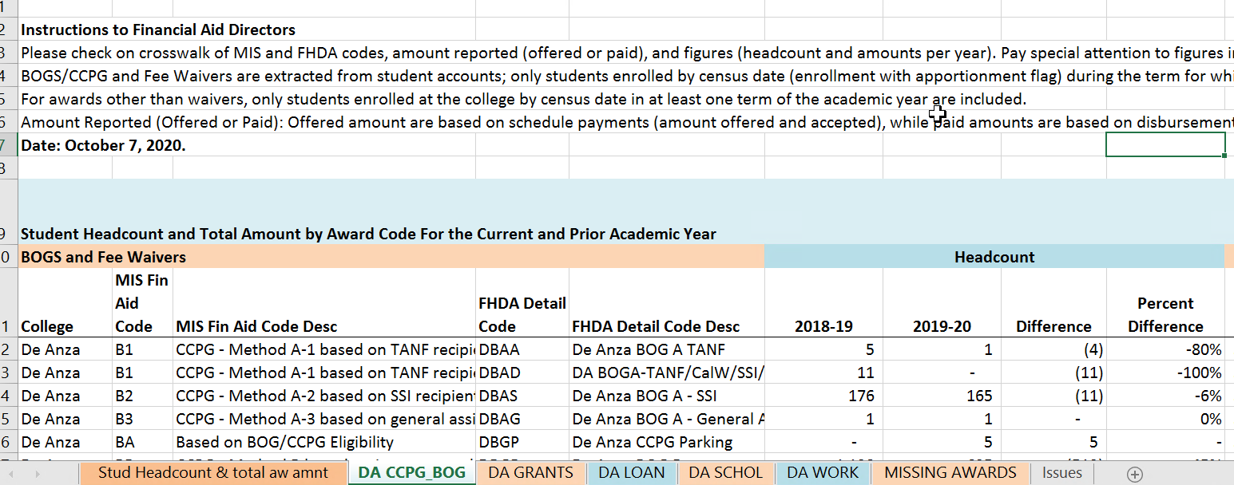
FHDA MIS FA-Awards, Preliminary Figures
Preliminary reports are available at: http://research.fhda.edu/mis_reports/mis_financial_aid/
Notes:
A “Preliminary Figures Report” is created for each college. The Excel format of the report allows the use of worksheets to display data by award type. Student headcount and award amount data are disaggregated by MIS/FHDA codes and academic year. Change statistics (difference, percent difference) are also included to help detect errors in the data or procedures (e.g., coding).

Slide 10
FHDA MIS SF, FA Submission
Data for preliminary figures is reviewed and confirmed
Extract current data from Banner. Test data using MIS server. If needed, make mods or submit MIS SI update
Data in FHDA-MIS code crosswalk is reviewed and confirmed
Submit SF & FA
Create and post submission report at the FHDA IRP MIS website

Slide 11
FHDA IRP MIS Financial Aid
This webpage provides access to documents related to the student financial aid reports (MIS SF, MIS FA) submitted by the Foothill-De Anza Community College District (FHDA) to the Management Information System (MIS) unit of California Community Colleges Chancellor's Office (CCCCO).
The documents include reports that show statistics for the data submitted. They are posted here to give data custodians at the financial aid offices for Foothill College and De Anza College the opportunity to review the data and report any issue that may indicate the need for resubmission.
http://research.fhda.edu/mis_reports/mis_financial_aid/

Slide 12
FHDA IRP MIS Financial Aid (cont.)
Reports and information available at the FHDA IRP MIS financial aid webpage (http://research.fhda.edu/mis_reports/mis_financial_aid/) include the following:
FHDA MIS Financial Aid Data Cleanup: Methods & Procedures
Crosswalk between FHDA and MIS codes
Preliminary Figures
Research Reports
MIS Student Financial Aid: SF (Applicants) Summary Statistics
MIS Financial Aid: Student Headcount by College, Award Type and Related SCFF Statistics
Review of SCFF Preliminary Metric Data

