Slide 1
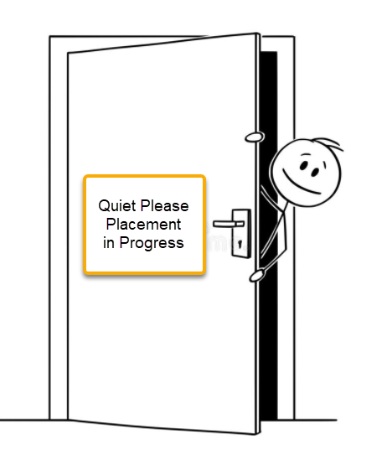
FHDA MIS Reports Student Placement (SL), Methods and Procedures
Lourdes del Rio-Parent, PhD
FHDA CCD IRP
October 2021

Slide 2
Presentation Objectives
At the end of this presentation, the audience will be able to describe:
Differences between the Traditional and Pathway placement models and their implications for reporting and analyzing data submitted in the MS SL (Student Placement) report.
Methods used to validate data for reporting, including the use of:
Crosswalk tables (parent and child tables) SOATEST and MIS SL data values
Placement course characteristics (credit status, transfer, pre-college level, TOP code) to identify SL02 Placement Type and SL06 Placement Level
Procedures to reduce meaningless or unnecessary data

Slide 3
Placement: Traditional Model, Math Sequence
Algebra
Statistics
Precalculus
Calculus
Pre-College Level
Assessment of students’ academic skill levels within a subject area or discipline to place them at the right course within a sequence. Emphasis was placed on the assessment of entry level skills using standardized tests.
Notes:
Let’s begin by discussing two approaches or models to course placement: Traditional and Pathways.
In the Traditional placement model, an assessment (e.g., standardized test, transcript evaluation) is made on whether students have the entry level skills required to succeed in a course (e.g., skills & knowledge taught in a prerequisite or prior course in the course sequence). Under this model, the default choice (“open registration”) are pre-collegiate level courses in the subject (e.g., ESL, English, Math).

Slide 4
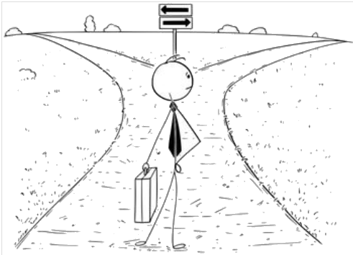
Placement: Pathways Model
Takes into account students’
Education goal
Program of studies (major)
Prior knowledge Indicators (e.g., GPA, academic history)
Provides opportunity for students’ input (self-guided placement)
Notes:
In the Pathways model, it is assumed that most first-time students who graduated from a high school in the US have the skills & knowledge to succeed in a college level courses in English or math. The purpose of the placement or placement services is to help students develop a pathway (e.g., education plan) to reach their education goal, after taking into account their program of studies and academic history. While the Traditional model prescribes placement, a key characteristic of the Pathways model is that students are encouraged to actively participate in this process by providing opportunities for self-guided placement. The Pathways model also strongly discourages placement in pre-college level courses (i.e., only allowed when it has been shown to be the best approach that leads to student success).

Slide 5
Placement: Pathway Model, Math
Based on education goal, program of studies and indicators of prior knowledge (e.g., High School GPA, academic history), students are assigned to a course sequence: SLAM (Statistics and Liberal Arts Math) or B-STEM (Business, Science, Technology, Engineering and Math).
The key difference between a SLAM and B-STEM course sequence is whether the program of study requires calculus.
No
Calculus required ?
Yes
SLAM B-STEM
Notes:
Specific to math placement, the central question is whether to place or recommend students to enrolled in a SLAM or B-STEM pathway or course sequence. Ideally, this would be primarily based on the student’s education goal (e.g., transfer to a four year institution) and program of studies (major requiring calculus). However, the student’s academic history (high school GPA or transcript evaluation) may initially limit enrollment to SLAM courses until the student can meet pre-requisites for B-STEM courses.

Slide 6
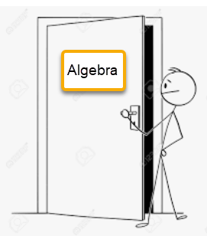
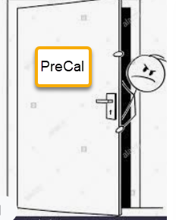
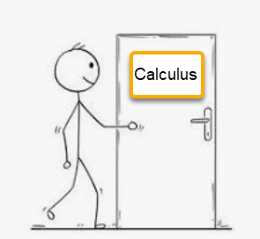
Gen Math Course Sequence: SLAM to B-STEM
SLAM
B-STEM
“Open Registration” Courses
“Controlled Registration”
Courses
Notes:
SLAM and B-STEM pathways can be viewed as sections of one general math course sequence. Under the new pathway model, only B-STEM courses are subject to registration control (i.e., checks for prerequisites or minimum test scores).
For most colleges, placement on a SLAM or B-STEM course sequence is based on high school GPA or academic history (transcript evaluation), which can be followed up with self-guided placement (i.e., placement data will show a series of placements for the same student during a short period of time).
Notice that students placed on a B-STEM course have the option to enroll in SLAM courses.

Slide 7
Placement: Traditional vs Pathways
Traditional Model
Placement in college level ESL, English, or math courses was dependent on the assessment of students’ skills & knowledge usually through standardized testing. Placement in pre-college level was determined when the student did not meet requirements (e.g., minimum test score) for college level coursework.
First-time or first-time transfer students who planned on taking ESL, English, or math college level courses were expected to take at least one placement test or bring their transcript for evaluation.
Pathways Model
Provides access to the college level course sequence for ESL, English, or math (at least the first course in the sequence). Depending on HS GPA or academic history, support may be required.
Placement data/records can be created automatically by the submission of a college admissions application, independently of whether the student intends to enroll in an ESL, English, or math course.
Encourages self-guided placement
Notes:
To summarize, key differences between the Traditional and Pathway placement model include:
1. Purpose of placement: In the Traditional placement model, the focus was on assessing the level of skills & knowledge within a specific subject area (e.g., elementary algebra to calculus). If the assessment determines the student lacks entry level skills or knowledge for college level work, the placement would recommend a pre-college level course.
In the Pathways model, the emphasis is on the student’s education goal and program of studies. Placement in college level course is the default.
2. Use of standardized testing: In the Traditional model, standardized testing was the norm; in Pathways, standardized testing is not used.
3. Data interpretation: In the Traditional model, students initiate the process (e.g., take at least one test); thus, placement data could be used as an indicator of the student’s intention regarding enrollment. In the Pathways model, placement data may not correlate with students’ intentions regarding enrollment; the placement record may have been created as a result of submitting a college admission application, independently of whether the student intended to register in an ESL, English, or math course.
4. Data analysis: Specific to the Pathways model, data for self-guided placement may not be available in regular placement files (e.g., Banner-SOATEST). There may be no evidence that the student used a tool developed by the college for placement.

Slide 8
MIS SL (Student Placement) Domain
The purpose of MIS SL is to report data on students’ placement in English, mathematics, or ESL courses occurring during the reporting academic year.
Notes:
The domain for the report is describe in the MIS DED, https://webdata.cccco.edu/ded/sl/sl.htm
Data source in Banner: SOATEST (student testing/placement data) and STVTESC (Banner validation table for test codes)

Slide 9
MIS SL Data Elements
SL01-PLACEMENT-DATE: Date the placement occurred
SL02-PLACEMENT-TYPE: Type of placement
A-English course placement
B-Business, Science, Technology, Engineering or Mathematics (B-STEM) pathways mathematics course placement
C-Statistics or Liberal Arts Mathematics (SLAM) pathways mathematics course placement
D-English as a Second Language–Writing course placement
E-English as a Second Language–Reading course placement
F-English as a Second Language–Speaking/Listening course placement
G-English as a Second Language–Grammar course placement
H-English as a Second Language–Listening course placement
I-English as a Second Language–Integrated course placement
Notes:
For SL02:
English placement (‘A’) is based on test code (STVTESC_Code) as identified by the Testing Center supervisor.
Math placement in B-STEM (‘B’) or SLAM (‘C’) is based on course characteristics (i.e., the highest level course based on the test-score combination), including credit status, transfer status, and pre-college level.
For De Anza College, math SLAM courses are those below precalculus (Finite Mathematics, Introduction to Contemporary Mathematics, Mathematics for Elementary Education, Statistics); B-STEM, precalculus and above.
At Foothill College, math SLAM courses are those with open enrollment (Intermediate algebra, Quantitative Reasoning, Liberal Arts Math, Elementary School Teacher Math, Statistics, Precalculus + required support); B-STEM, precalculus with no support and above.
ESL placement (‘D’ to ‘I’) is based on the TOP code for the course (i.e., the highest level course based on the test-score combination).

Slide 10
MIS SL Data Elements (cont.)
SL03-PLACEMENT-SOURCE-HIGH-SCHOOL: Whether the placement was based on high school grades and/or GPA and the methodology used to make the placement.
A-High school grades/GPA using the Statewide Default Placement Rules
B-High school grades/GPA using local placement methodology
N-Placement not based on high school grades/GPA
Notes:
SL03 is based on test code (Banner-STVTESC_Code) as identified by the Testing Center supervisor.

Slide 11
MIS SL Data Elements (cont.)
SL04-PLACEMENT-SOURCE-GUIDED-SELF: Whether the placement was based on guided and/or self-placement and the methodology used to make the placement.
A-Guided placement: Locally developed tool or process, potentially in consultation with counselors or other faculty, used to place students into a course.
B-Guided self-placement: Locally developed tool or process, potentially in consultation with counselors or other faculty, in which student is given a placement recommendation, but students are ultimately allowed to choose their placement.
C-Self-placement: Process by which students may be provided information about courses and other self-assessment but no recommendation is made and student chooses their own placement.
N-Placement not based on guided or self-placement
Notes:
SL04 is based on test code (Banner-STVTESC_Code) as identified by the Testing Center supervisor.

Slide 12
MIS SL Data Elements (cont.)
SL05 PLACEMENT-SOURCE-TEST: Whether the placement was based on a standardized assessment test.
A-Standardized assessment test
N-Placement not based on standardized assessment test
Notes:
SL05 is based on test code (Banner-STVTESC_Code) as identified by the Testing Center supervisor.

Slide 13
MIS SL Data Elements (cont.)
SL06-PLACEMENT-LEVEL: Level of placement relative to the gateway transfer-level course in the discipline.
T-Transfer-level placement with no support recommended
R-Transfer-level placement with support recommended
S-Transfer-level placement with support required
A-One level below transfer-level placement
B-Two levels below transfer-level placement
C-Three levels below transfer-level placement
D-Four levels below transfer-level placement
E-Five levels below transfer-level placement
F-Six levels below transfer-level placement
G-Seven levels below transfer-level placement
H-Eight levels below transfer-level placement
Notes:
SL06 is based on:
- Characteristics for the course (course placement based on test-score combination), which include credit status, transfer status, and pre-college level
- Whether there is a co-requisite (recommended or required) based on the test-score combination, as identified by the Testing Center supervisor.

Slide 14
MIS SL Development Main Steps
Meet with data custodians and area managers to discuss report specifications and related data sources.
Develop crosswalk tables to process placement data shown in Banner-SOATEST.
Research placement student records for the reporting academic year and both colleges to identify issues to take into account when SQL scripts to extract/process data for the report.
Develop and test SAS scripts to submit the report.

Slide 15
MIS SL Development Main Steps
Meet with data custodians and area managers to discuss report specifications and related data sources.
Develop crosswalk tables to process placement data shown in Banner-SOATEST.
Research placement student records for the reporting academic year and both colleges to identify issues to take into account when developing SQL scripts to extract/process data for the report.
Develop and test SAS scripts to submit the report.

Slide 16
Crosswalks Tables: MIS_SL_STVTESC
MIS_SL_STVTESC is the parent table and includes the following:
COLLEGE: De Anza or Foothill
ACADEMIC_YEAR: Reporting academic year
SUBJECT: English, ESL, Math, or Other
STVTESC_CODE: Banner test code
STVTESC_DESC: Banner test code description/label
SL02_PLAC_TYPE: Identifies English placement codes only
SL03_PLAC_SRC_HIGH_SCH: Crosswalk of STVTESC and MIS SL03 codes
SL04_PLAC_SRC_GUI_SELF: Crosswalk of STVTESC and MIS SL04 codes
SL05_PLAC_SRC_TEST: Crosswalk of STVTESC and MIS SL04 codes
Notes:
Two crosswalk tables were developed to process data extracted from the production system.
MIS_SL_STVTESC is the parent table and it provides a crosswalk between test codes in STVTESC and applicable MIS SL codes (mainly SL03, SL04, SL05). Data from MIS_SL_STVTESC is then cascaded/passed on to MIS_SL_TESC_SCORE (i.e., child table).

Slide 17
Crosswalks Tables: MIS_SL_TESC_SCORE
MIS_SL_TESC_SCORE is the child table and includes the following:
COLLEGE: De Anza or Foothill
ACADEMIC_YEAR: Reporting academic year
SUBJECT: English, ESL, Math, or Other
STVTESC_CODE: Banner test code
STVTESC_DESC: Banner test code description/label
TEST_SCORE: Banner test score
COURSE_SUBJ: Banner subject code for main course
COURSE_NUMB: Banner number code for main course
COURSE_TITLE: Banner title for main course
SUPPORT_RECOMM: Identifies if the placement, based on test score, requires or recommends co-enrollment in support course.
Notes:
MIS_SL_TESC_SCORE inherits data from MIS_SL_STVTESC; it shows a crosswalk between test code-score combination and applicable MIS SL codes (mainly SL02 and SL06).

Slide 18
Crosswalks Tables: MIS_SL_TESC_SCORE (cont.)
CB21_CRSE_PRIOR_TO_COLL: CB21 for main course
CB03_CRSE_TOP_CODE: CB03 for main course
CB05_CRSE_TRANF_ST: CB05 for main course
CB04_CREDIT_ST: CB04 for main course
COURSE_MATH_STEM: Identifies math B-STEM course (pre-calculus or higher)
SL02_TYPE_SCORE: SL02 from parent table for English; for Math, SL02 based on
“COURSE_MATH_STEM”; for ESL, SL02 based on course TOP code
SL03_HIGH_SCH_SCORE: SL03 from parent table
SL04_GUI_SELF_SCORE: SL03 from parent table
SL05_TEST_SCORE: SL05 from parent table
SL06_PLAC_LEV_SCORE: SL06 based on CB data and “SUPPORT_RECOMM”

Slide 19
MIS_SL_TESC_SCORE: SL02 & SL06 Coding
Main purpose of MIS_SL_TESC_SCORE table is identify values for SL02, placement type, for math and English and SL06, placement level.
SL02 for math: When the math test-score combination allows the student to register in pre-calculus with no required support, or above, then placement is classified as B-STEM. Test-score combinations that do not allow registration in a pre-calculus course without support are classified as SLAM.
SL02 for ESL: Based on the TOP code for the course linked to the test-score combination (code for ESL integrated, writing, speaking, or listening) .
SL06: Primarily based on the CB05 & CB21 for course linked to the test-score combination and whether support is required or recommended.
Notes:
The key purpose of MIS_SL_TESC_SCORE is to identify the highest level course based for each valid test code-score combination. The table also identifies whether support is required or recommended. The placement course and support status define the placement level (SL06). The placement course is also used to identify placement type (SL02) for math (i.e., SLAM or B-STEM) and ESL (e.g., integrated, writing, speaking, listening).

Slide 20
Rationale for the Use of Crosswalk Tables
Facilitates establishing, reviewing, and updating relationships between data fields
Cascade data across tables
Information on the parent table (test code-MIS SL code) can be passed on to the child table.
Expand information when linked to other tables
Descriptors or labels from lookup tables can be added to facilitate review
Export to documents (e.g., Excel, CSV) for review by data custodians
Simplifies coding for updates
Supports data cleanup for it can be used to identify test codes and test-scores combinations to be included or excluded from the final data set.

Slide 21
Rationale for the Use of Crosswalk Tables (cont.)
Notes:
Data in a crosswalk table can be exported to Excel and sent to data custodians (i.e., Testing Supervisors) for review.

Slide 22
Research Placement Data
SORTEST
Key purpose: to store data used to control access to course registration.
Processes for data entry/processing may differ across colleges
May need to be processed significantly to be used for research or reporting
Example: Math scores declining in consecutive dates
Used by the college to control registration in math courses but undermines the validity of the data for research or reporting (i.e., difficult to understand or process)
Notes:
After reviewing data in Banner-SORTEST (Banner form SOATEST), it was determined that we needed to eliminate noise or unnecessary redundancy in the data.

Slide 23
Research Placement Data (cont.)
Multiple placement records may be created in Banner-SOATEST to facilitate course registration; however, this practice may introduce noise and cause confusion during data analysis. For example, records in Banner-SOATEST may show students placed on statistics and precalculus on the very same date, even when one may expect only one record showing the highest level in the course sequence.

Slide 24
Research Placement Data: Example 1
Notes:
In this example, the highest course placement in a given activity date was selected. If a lower score was reported in a later date, that record is not included in the MIS report.

Slide 25
Research Placement Data: Example 2
Notes:
In this example, the highest course placement in a given activity date was selected. If a higher score was reported in a later date, that record is included in the report.

Slide 26
Questions?

