Slide 1
MIS Updates: Adult Education Assessment, Long Life Learning, and Student Placement
Lourdes del Rio-Parent, PhD
Foothill-De Anza CCD April 20, 2021

Slide 3
Justification for New MIS Reports
“Under AB 1805, colleges are required to report both their placement results publicly in 78221.5 (c), and to the Chancellor’s Office in 78221.5 (b) (2) (A). Under the new Credit for Prior Learning Regulations (§ 55050), districts had to certify that the policies required by the section to be adopted and implemented, § 55050 (n), which included the ability to report data for students receiving CPL including credits awarded to the Chancellor’s Office, § 55050 (l).
As a result, every college will have to report the data represented by these new data files to the Chancellor’s Office via one method or another. Reporting through the MIS system, however challenging the first year of reporting may be, will be the most effective method by which the field can accomplish this mandated reporting and greatly increase the likelihood of that data being reported efficiently, meaningfully, and accurately.” (Barney Gomez, Vice Chancellor of Digital Innovation and Infrastructure; email sent on March 26, 2021)

Slide 4
Goal and Objectives
Goal: Gain a general understanding of the main purpose and requirements related to the following new MIS reports:
Adult Education Assessment,
Long Life Learning
Student Placement
Objectives
Identify data sources (e.g., Banner forms and data fields)
Explore issues that may impact data validity and reporting
Decide on initial data cleanup and reporting procedures

Slide 5
MIS AA, Adult Education Assessment
Annual report
Deadline October (prior academic year data: July 1 to June 30)
Applicable only to colleges with adult education programs
Purpose: Report assessment results for students in adult education programs
Need to identify:
Person(s) in charge of conducting this type of assessment (e.g., instructors or program coordinators)
Data sources (e.g., data files maintained by instructors or program coordinators)

Slide 6
MIS AA, Adult Education Assessment
Report Domain

Slide 7
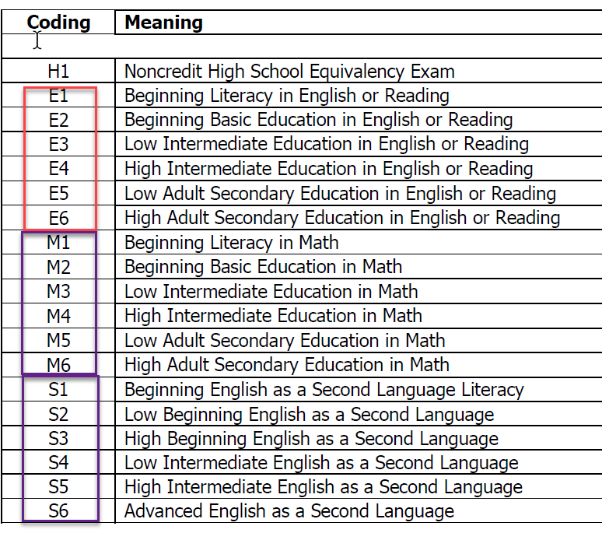
AA02 Assessment Result
Note
Data for MIS AA need to include: (1) FHDA student ID, (2) assessment date, and (3) a score or result that can be coded/reported using the coding in AA02.

Slide 8
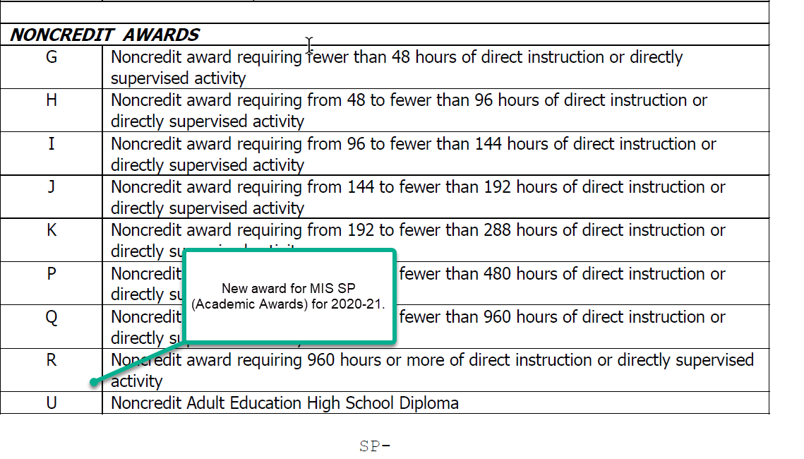
Adult Education, MIS SP Award
Questions
Is obtaining a HS diploma among the possible outcome for the adult ed program at the college(s)? Is yes, who keeps track of this outcome?

Slide 9
Adult Education, “To Do”
For colleges with adult education programs, please provide the following information:
How are adult education students identified (e.g., student type, course enrollment, section enrollment)?
Who is(are) the program coordinator(s)/person(s) in charge?
Is there any type of assessment for course/class placement? If yes, who are the data custodians for the adult education programs?

Slide 10
Adult Education
Questions, issues, concerns?

Slide 11
MIS SL, Student Placement
Information on student placements related to:
English
Mathematics
ESL
Annual report, due on October, for course placement during the prior academic year

Slide 12
MIS SL, Student Placement
Report Domain

Slide 13
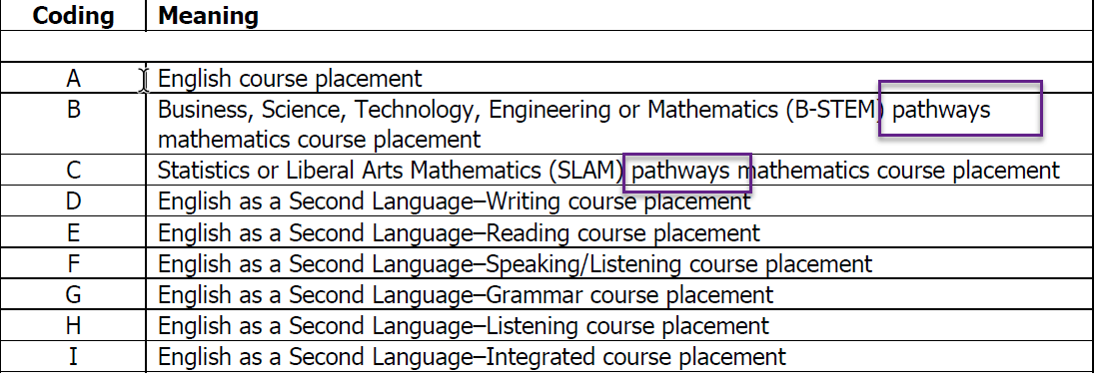
MIS SL02, Student Placement Type
Questions: Is the CCCCO Guided Pathways framework used for student placement at the college(s)? Do data (coding) for placement in math courses take students’ “pathway” into account?

Slide 14
MIS SL03, Student Placement Source High School
Indicates whether the placement was based on high school grades and/or GPA and the methodology used to make the placement.

Slide 15
MIS SL04, Student Placement Source Guided
Indicates whether the placement was based on guided and/or self-placement and the methodology used to make the placement.
Guided placement: Locally developed tool or process, potentially in consultation with counselors or other faculty, used to place students into a course.
Guided self-placement: Locally developed tool or process, potentially in consultation with counselors or other faculty, in which student is given a placement recommendation, but students are ultimately allowed to choose their placement.
Self-placement: A process by which students may be provided information about courses and other self-assessment but no recommendation is made and student chooses their own placement.

Slide 16
MIS SL04, Student Placement Source Guided (cont.)
Questions: Have colleges implement guided placement processes/tool? Is yes, do we have data that can be used to identify if the student use guided placement, guided self-placement, or self-placement?

Slide 17
MIS SL05, Student Placement Source Standardized Test
Indicates whether the placement was based on a standardized assessment test.
Note: Applies only to ESL course placement

Slide 18
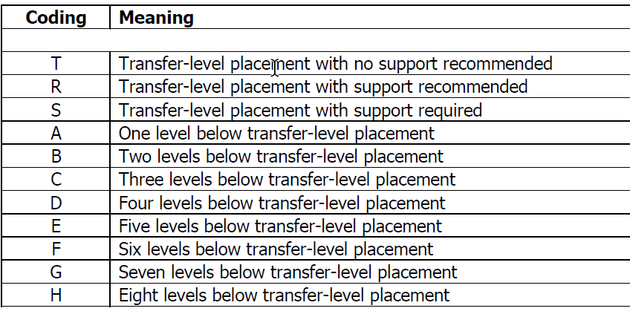
MIS SL06, Student Placement Level
This element indicates the level of placement relative to the gateway transfer-level course in the discipline.

Slide 19
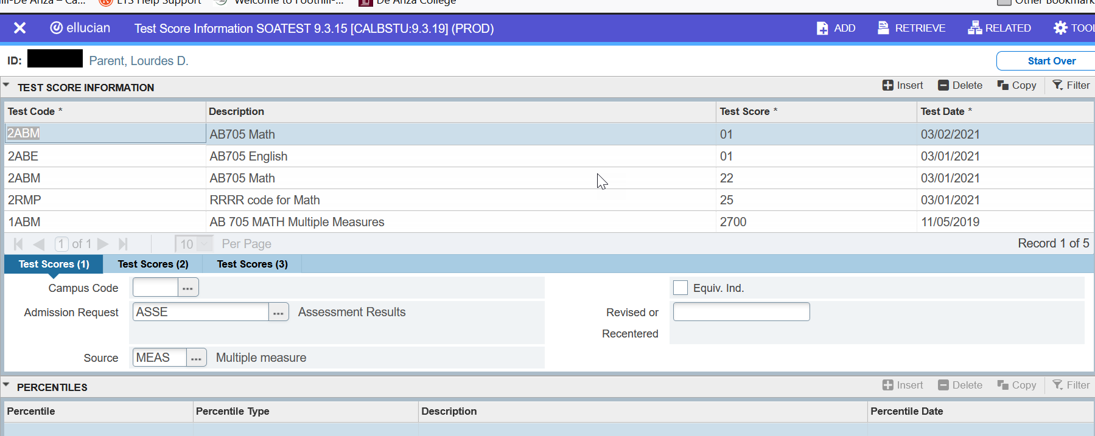
MIS SL, Student Placement, SOATEST

Slide 20
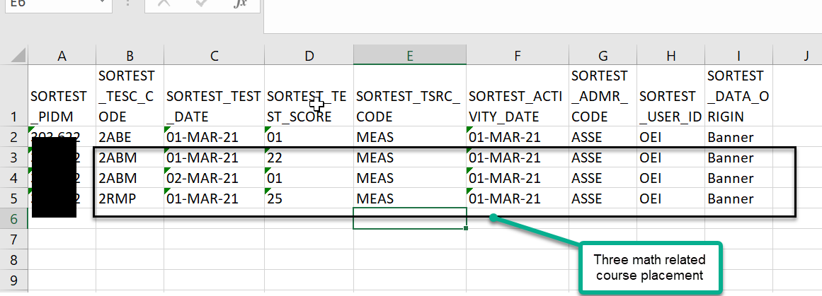
MIS SL, Student Placement, SORTEST
Note
SORTEST is the back-end table of SOATEST.

Slide 21
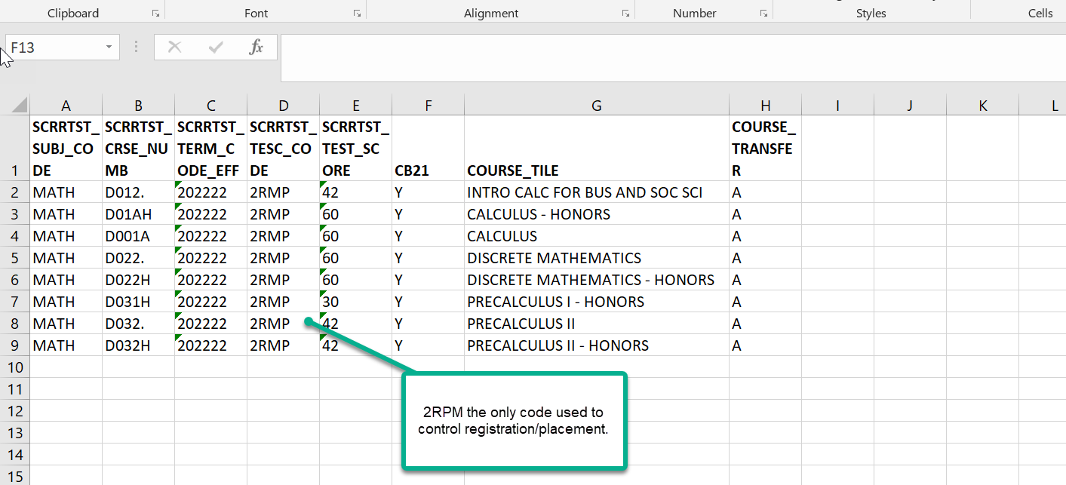
MIS SL, Student Placement, SCRRTST
Note
SCRRTST sets course pre or co-requisite based on enrollment or test code and score. When linked to SOATEST data, it can be used to describe placement.

Slide 22
MIS SL, Student Placement, SCRRTST (cont.)
CB course data can be used to identify transfer status and college level status (levels below transfer)
CB05 Course transfer level
CB21 Course Pre-College Level

Slide 23
MIS Student Placement, “To do”
Data Custodians: Review and use Excel file “SL_Student_Placement_FHDA” to classify Test codes used, so far, in 2020-21.

Slide 24
MIS Student Placement
Questions, issues, concerns?

Slide 25
MIS SY Student Credit for Prior Learning
Information on student credit for prior learning assessed during the reporting term.
One record is submitted for each combination of student and course for which a student was assessed for credit for prior learning during the reporting term.
To be included in the MIS quarterly submissions.

Slide 26
MIS SY Student Credit for Prior Learning (cont.)
Report Domain

Slide 27
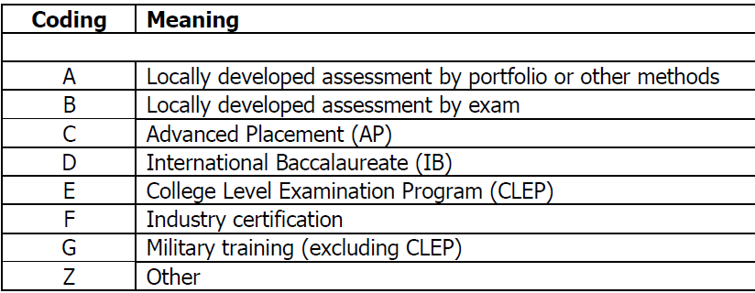
MIS SY02 Student Credit Assessment Method
Indicates the method used to determine credit for prior learning.
Questions: Which of these methods are used by the college(s)?

Slide 28
MIS SY03 Student Credit Units Awarded
Number of units that the student was awarded as credit for prior learning in association with the reported course.
Referential Checks:
If Student Credit Grade (SY04) is coded as A, B, C, D, or P, then SY03 must be:
Greater than or equal to Course Units of Credit Minimum (CB07), and
Less than or equal to Course Units of Credit Maximum (CB06).

Slide 29
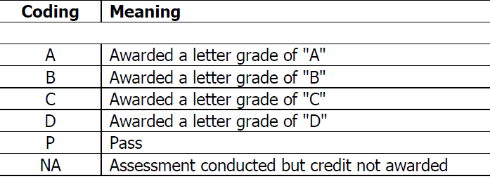
MIS SY04 Student Credit Grade
Indicates the grade the student was awarded in association with the credit for prior learning.
Integrity check:
If Student Credit Grade (SY04) is coded as “NA”, then Student Credit Units Awarded (SY03) must be coded as 0000.

Slide 30
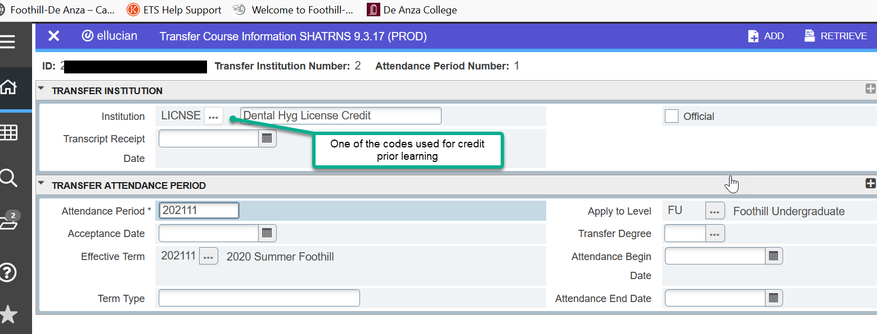
MIS Credit for Prior Learning, SHATRNS

Slide 31
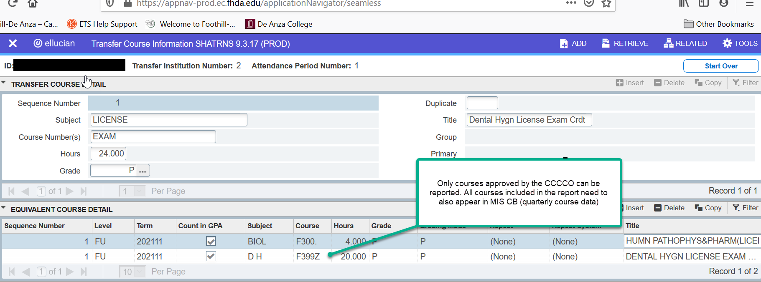
MIS Credit for Prior Learning, SHATRNS (cont.)

Slide 32
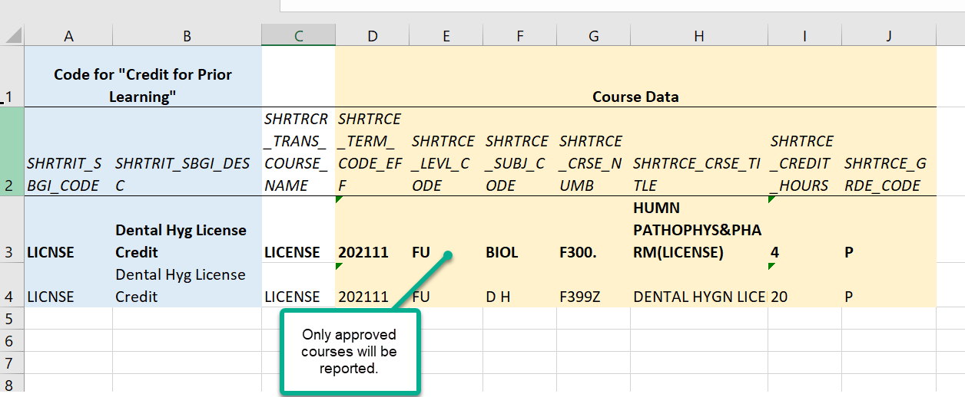
MIS Credit for Prior Learning, Banner “Back-end” Data

Slide 33
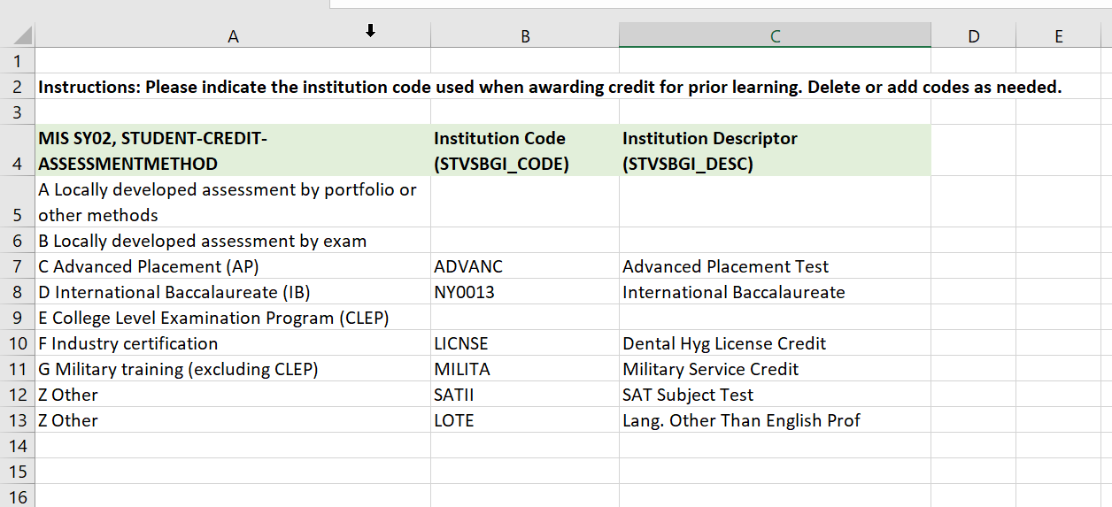
MIS Credit for Prior Learning, “To Do”
Crosswalk STVSBGI code and SY02 codes. Notice that you can link more than one STVSBGI code to a given MIS SY02 code. Delete/add as needed.

Slide 34
MIS Credit for Prior Learning
Questions, issues, concerns?

