Slide 1
MIS Student Success
Review of MIS SS Report Specifications & Data Sources, Foothill College
By Lourdes del Rio-Parent, PhD
Office of Institutional Research & Planning Foothill-De Anza CCD
May 4, 2015

Slide 2
MIS Reporting and Data Validity
Data validity is the degree of confidence we have on the data; the extent to which the data can be used to support meaningful decisions.
Data validation processes (e.g., clean-up) are triggered by the MIS reporting cycle and require the involvement of data custodians/users throughout the whole process.

Slide 3
MIS Reports

Slide 4
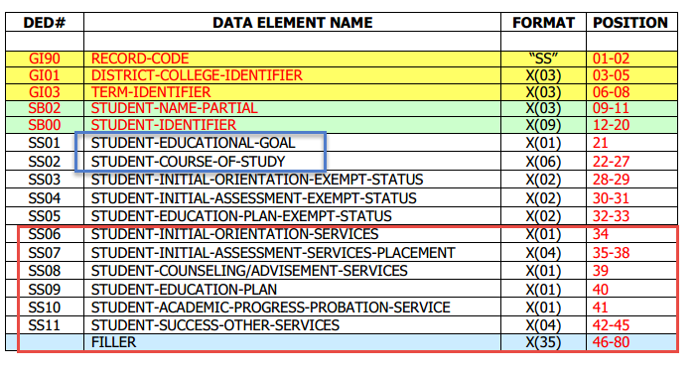
MIS SS Domain

Slide 5
MIS Reporting Cycle
Report Specifications
Users
Analyst
MIS Student
Success
(SS)

Slide 6
Key Information about MIS SS
Will determine up to 60% of total funding for 3SP programs (40% based on headcount of credit, CA resident students)
However, 80% of prior year funding is guaranteed for the
1st year of implementation (2015-16); the following year, 50%.
Data from MIS SS…
Will be subject to audits
Expected to be used for research-- assess outcomes of SS activities
Quantitative approach to data analysis/research
Whole = sum of all the parts (breakdown of data based on factors or independent variables)
Test for discrepancies in the data
To maximize funding: Keep in mind that services provided will be based on student headcount; reach out and try to serve as many students as possible.

Slide 7
3SP Core Services
Orientation
Initial, substantive
Once during CA (college attendance)
Initial
(ENG, ESL, MATH)
Once during CA (college attendance)
Education Plan Development
Abbreviated: Initial, short term goal, no major
Comprehensive: long term education goal, with declared major
Assessment
Placement
Once CA
Counseling
Once per academic year, credit
Academic Progress
Intervention
Every term, credit load >= 0.5

Slide 8
MIS SS11 (Follow-ups)
Orientation
Special program (e.g., Pass the Torch)
Follow-up to initial orientation
Placement
Retest-ENG, MATH, ESL
Other subjects, career, interest, or subsequent placement assessment services
Ed plan development
Modifications
Developments after initial abbreviated/comprehensive
Other
Counseling/advising after first one in academic year

Slide 9
Initial Orientation (SS06)
First substantive orientation
(1) academic expectations; progress and probation standards, (2) maintaining registration priority, (3) prerequisite or co-requisite challenge process, (4) maintaining fee waiver eligibility, (5) descriptions of services and programs, (6) academic calendar and important timelines, (7) registration and college fees, (8) available education planning services, and (9) other issues such as policies, and procedures the college deems necessary.
Data sources:
SOAR (Banner-Spaiden)
Course enrollment during the reporting term, CNSL005

Slide 10
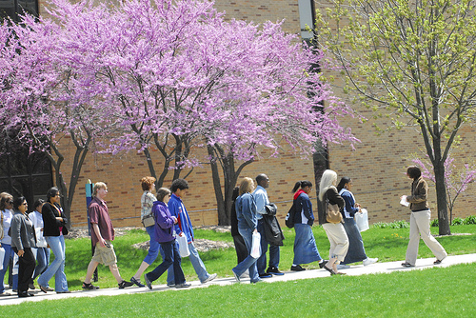
Orientation Follow-up (SS11)
Other orientation services
Follow-up to an initial orientation (follow-up term)
Orientation(s) by special programs
Pass the Torch, Puente
Missing sources?
Online orientation?

Slide 11
Initial Placement (SS07)
Initial assessment for placement in English, Math, or ESL
Data Sources:
Testing Office (SOATEST)
Transcript Evaluation (SOAPCOL)
Registration Override/Clearance (SFASRPO)

Slide 12
Placement Follow-up (SS11)
Re-testing related to English, ESL, or MATH assessment/placement; placement for other subjects; career interest or exploration assessments
Data sources:
Same as initial placement for re-testing in follow-up term
Courses:
ALCA201, ALCB231, ALCB231X , ALCB231Y, ALCB231Z, CRLP055, CRLP070, CRLP070S, CRLP070T, CRLP071, CRLP072, CRLP073, CRLP074, GID 060, MUS 050C VART050

Slide 13
Placement Follow-up (cont.)
SARS, Counseling Center
Transcript Evaluation
Petition for degree or certificate
Assessment Test Results
Clear prerequisite blocks
Remove Counseling 50 hold
SARS, Disability Resource Center (later, Clockworks)
Pre-Screen LD Specialist
Testing LD Specialist
LD Specialist Testing

Slide 14
Counseling (SS08)
Courses: Enrollment in CNSL courses
Categorical Programs: Data from MIS SE (EOPS), SD (DSPS), CW (CalWorks)
Student list for each program must be reviewed/confirmed by program coordinator
Special Populations: Data from MIS SG (Middle College & Puente)
Student list for each program must be reviewed/confirmed by program coordinator

Slide 15
Counseling-SARS, Counseling Center
Career Counseling
Choose Classes
Choose Major
TAA/TAP/TAG
Veteran Advising
Advising
Drop-In*
Transfer Agreement Workshop
Personal Problems
A Telephone Appointment
Transfer Counseling
Appointment for Bio/Health Programs
Personal Counseling
Assist choosing classes for this quarter (quick)
Referral

Slide 16
Counseling-SARS, Transfer Center
Transfer Counseling
Session with a College representative
Workshop for TAA
How to write your essay workshop
Assist students preparing resumes
Prepare students for job interviews
Assist student in finding careers
Career Advising
TAG Workshop
Application Workshop
Essay review assistance
Ask transfer questions
UC Online Tag Workshop
Selected Workshop
Drop-In to speak with college rep
Transfer Questions
Drop In with a Transfer Counselor

Slide 17
Counseling-SARS, Career
Assist student in finding careers
Prepare students for job interviews
Assist students preparing resumes
Other
Resume Critique
Job search techniques
Class Assignment for CRLP/CNSL 50
Drop In with a Transfer Counselor

Slide 18
Counseling-SARS, EOPS Department
Adding or Dropping Classes
Career Counseling
Drop in
Personal Matter
Transfer Questions

Slide 19
Counseling-SARS, Disability Resource Center
Learning Disability Specialist
DRC Counseling Appointment
Other
Registration Help
Drop-in Quick Question
Drop-in Margo Dobbins
Drop-in Bea Cashmore
Drop-in Jess Miller
Veteran
A Telephone Appointment
Advising
Career Counseling
Personal Counseling
Drop in with Janet Weber
Drop-in LeeAnn Emanuel
Service LD Specialist
Review LD Specialist
Counseling
Ed Coach Program

Slide 20
Counseling: Initial or Follow-up Service
Student received counseling/
advisement service
Is this the first contact/service during academic year for the student?
Yes
No
Report as counseling service
Report as follow-up

Slide 21
Education Plan Development
Abbreviated: First term at EOPS, DSPS, CalWorks or an approved plan developed in Degree Works during the reporting term with one or two terms
Comprehensive is operationally defined as an approved plan in Degree Works with 3 or more terms. The student must have…
A declared major
Enrolled in at least 0.5 unit during the term the plan was developed
Only one abbreviated and one comprehensive are reported during the student attendance at the college. Modifications to an approved plan during a follow-up term are reported as a follow-up service.

Slide 22
Education Plan Development Follow-up
Modifications to an approved plan during a follow-up term
Student must be enrolled in at least 0.5 credit unit
SARS
Create Educational Plan
Petition for over 120 units-Financial Aid Ed Plan
Educational Plan
Over the Time Limit Ed Plan
Education Plan

Slide 23
Academic Probation (SS10)
Student…
On probation/disqualification on the prior term and documented as receiving counseling/advisement or academic probation services during the term in SARS
Documented as receiving academic probation services during the reporting term in SARS , independently of academic standing

Slide 24
Academic Probation-SARS
Counseling
Probation/Disqualification
Disqualified
Financial Aid
Appeal for Disqualification
EOPS
EOPS Probation
Academic Probation
Academic Hold

Slide 25
Got questions?

