Slide 1
Data Collection and Reporting for MIS Student success (SS)
De Anza College, May 23, 2017
Lourdes del rio-Parent, PHD
Sr. Research Analyst/Data Warehouse Coordinator
Foothill-De Anza Community college district

Slide 2
Presentation Goals
Recognize the importance of:
Recording accurately sessions/appointments in SARS for MIS SS reporting
Using proper SARS reason codes to describe all services provided

Slide 3
Key attributes of MIS SS Reporting
MIS SS data has a significant impact (60%) in final allocations for student services at the college.
Districts report detailed information
Student ID
Type of services provided, including orientation, placement, education plan development, counseling, academic progress/probation and follow-ups (orientation, placement, career interests, counseling)
When was the service provided (Date of service)
During state audits, districts must provide evidence that “claimed” services in MIS SS were provided.

Slide 4
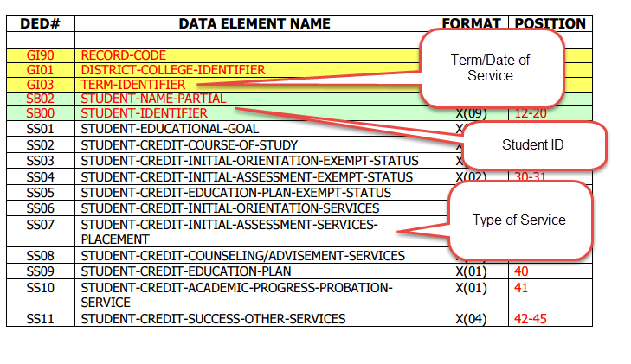
MIS SS Domain
Notes:
Available at: http://extranet.cccco.edu/Portals/1/TRIS/MIS/Left_Nav/DED/Data_Elements/SS/SS_Student_Success_Domain.pdf

Slide 5
Data accuracy
Data validity is the backbone of research
Validity: the extent to which inferences can be made based on research findings.
“Garbage in, garbage out”
Data accuracy is a “prerequisite” to data validity.
Institutions with accurate data are likely to obtain favorable results during a state audit
Negative findings during an audit may cause the institution to loose previously allocated funds. Because audit findings are made public, such findings will likely impact its prestige.

Slide 6
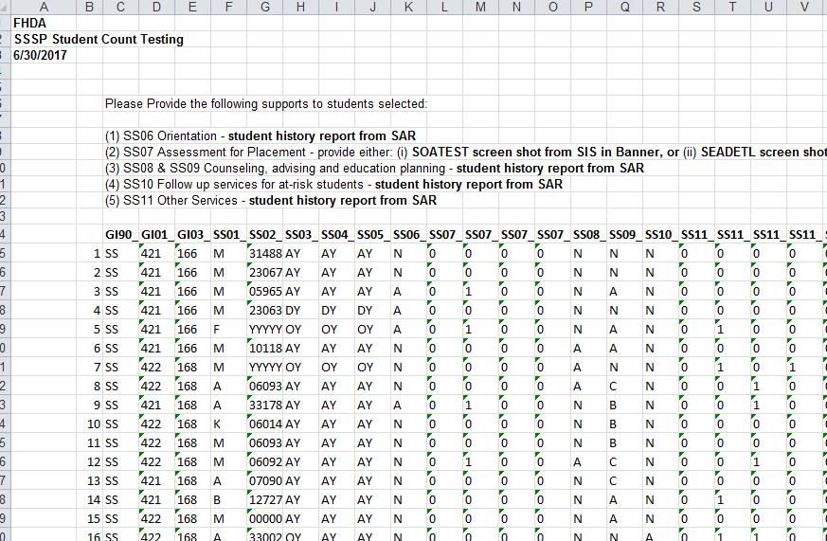
Audit Request, 2017
Notes:
Part of MIS SS Sample for Audit

Slide 7
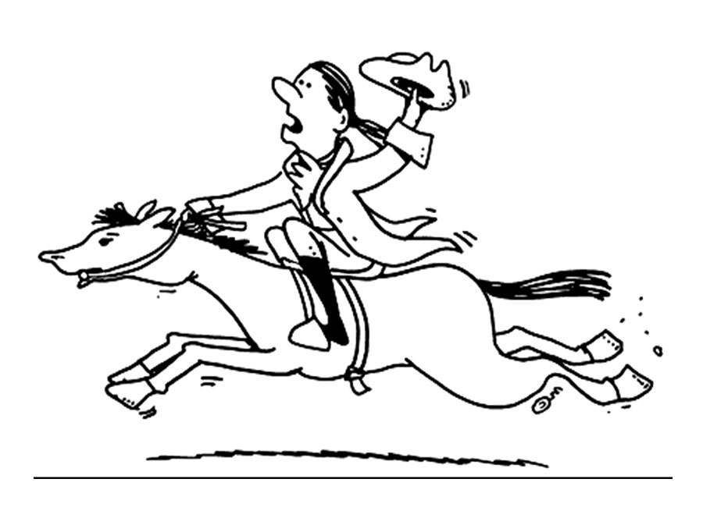
The auditors are coming…

Slide 8
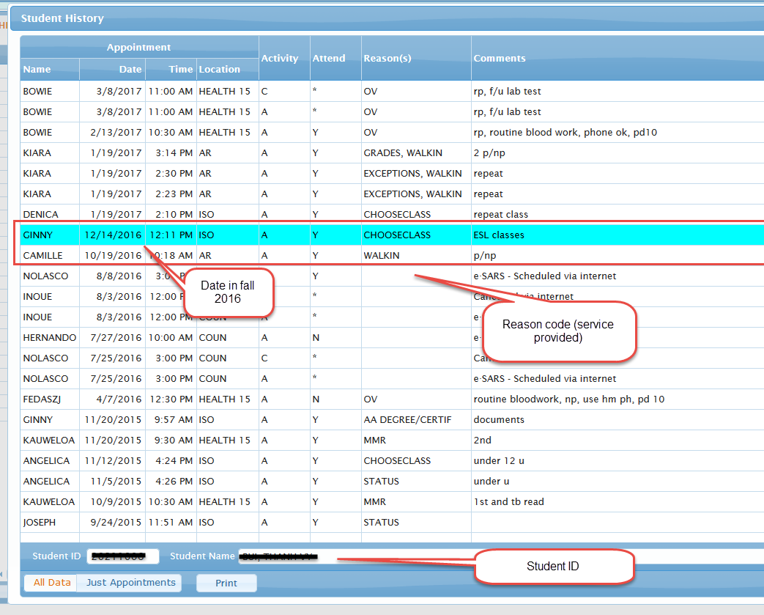
Evidence of Service for Audit (SARS Screenshot)

Slide 9
FHDA MIS SS: SARS lookup
Available at: http://research.fhda.edu/mis_reports/mis_ss_student_success/mis_ss_methods/index.html
Notes:
FHDA Institutional Research web site: http://research.fhda.edu/mis_reports/mis_ss_student_success/mis_ss_methods/index.html

Slide 10
FHDA SARS MIS Lookup
The lookup table allows easy tracking and crosswalk between each local SARS reason code used by any SARS location at the college and the corresponding MIS SS service code. SARS reason codes can vary across locations within the college.
College
Location
MIS SS Code
Reason code

Slide 11
MIS SS-SARS Data Cycle
SARS
Look-up
MIS SS Rep
Audit
Note: Funds are contingent on favorable audit findings.

Slide 12
What’s Next?

Slide 13
Action items
Assess reason codes at your SARS location and make any necessary modifications (e.g., add or delete codes).
Review crosswalk of SARS reason code and MIS SS code in lookup table available at: http://research.fhda.edu/mis_reports/mis_ss_student_success/mis_ss_methods/index.html
Report to the MIS coordinator any needed modifications to the lookup table.
Monitor and evaluate use of SARS in your location.

