Slide 1
Foothill-De Anza Community College District – Districtwide Overview
Board of Trustees Study Session
June 24, 2026

Slide 2
Overview
Our Programs
About our Students
Enrollment Patterns by:
  Service Area
  Modality
  Career Technical Education
Student Outcomes
Enrollment Trends
Staffing Trends
Stability Fund
Silicon Valley Regional Trends

Slide 3
Our Programs

Slide 4
Across the district we offer nearly 500 program options.
De Anza College:
Degree Program = 86
Associate Degree for Transfer = 24
Credit Certificate = 135
Noncredit Certificate = 30
Bachelor Degree = 1
Foothill College:
Degree Program = 55
Associate Degree for Transfer = 30
Credit Certificate = 103
Noncredit Certificate = 30
Bachelor Degree = 2

Slide 5
Students may select from over 80 Career Technical Education Programs
De Anza = 27 Programs
Law and Public Safety
Energy, Environment and Sustainable Buildings
Real Estate
Automotive and Manufacturing
Foothill = 54 Programs
Apprenticeship
Dental Assisting
Respiratory Therapy
Sports Medicine
Geographic Information Systems Technology

Slide 6
About
Our
Students

Slide 7
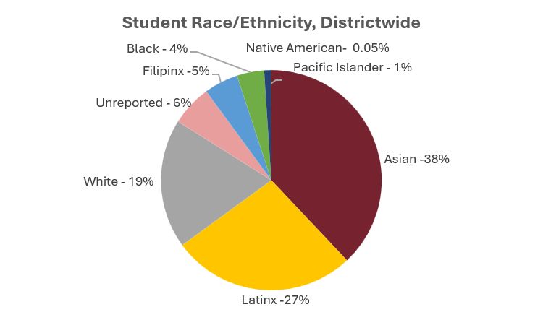
Students who identify as Asian or Latinx comprise 65% of district enrollment.
All apportionment enrollments in 2025-26

Slide 8
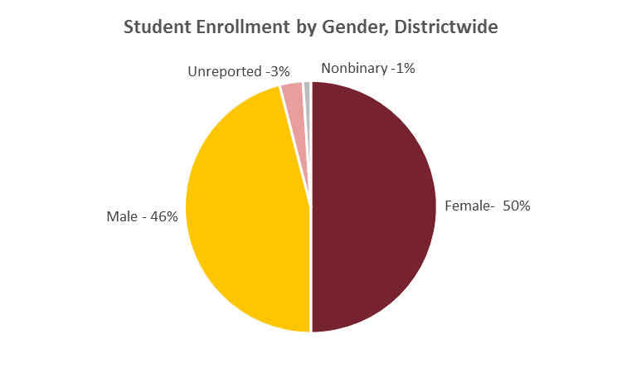
Enrollment by gender is about equally distributed between male and female students.
All apportionment enrollments in 2025-26.

Slide 9
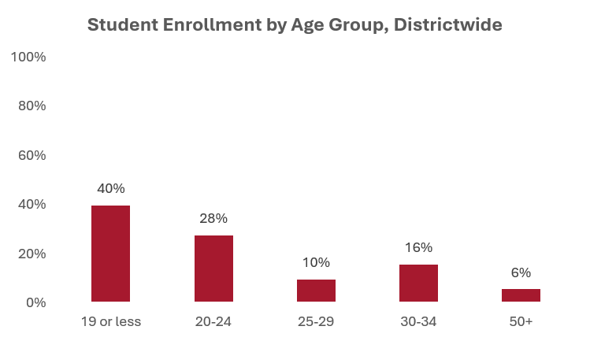
Enrollment of students under 25 years of age comprise 68% of total enrollment.
All apportionment enrollments in 2025-26.

Slide 10
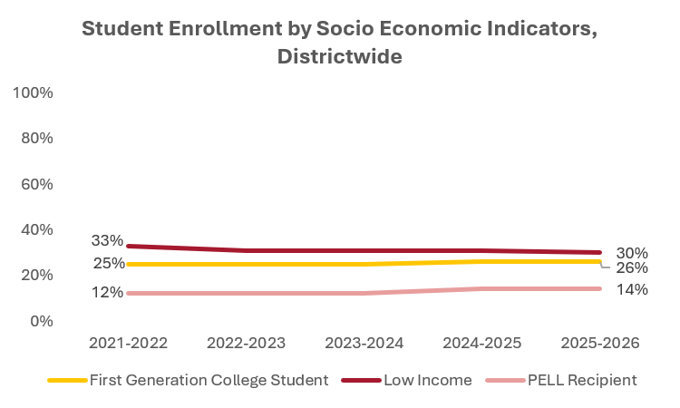
A third of students identify as low income while a quarter are first generation college students.
All apportionment enrollments. Low income is defined as a family of 4 at $50,000. First generation no parent or guardian has any college experience. PELL is often used as an indicator for low income. Indicators are not mutually exclusive.

Slide 11
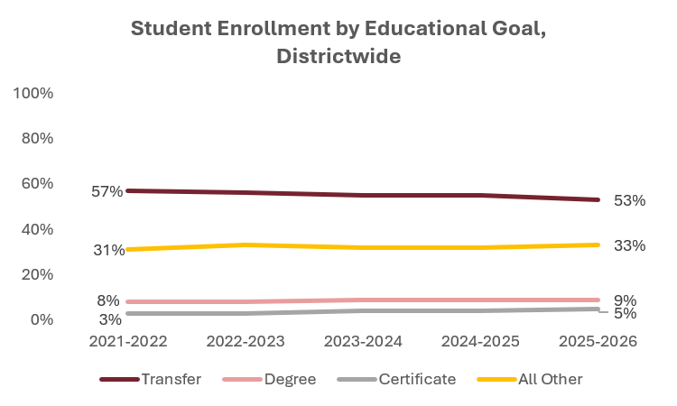
Over half of students declare a goal of transfer.
All apportionment enrollments. All other education goal includes career upskilling and personal enrichment.

Slide 12
Enrollment Patterns by Service Area

Slide 13
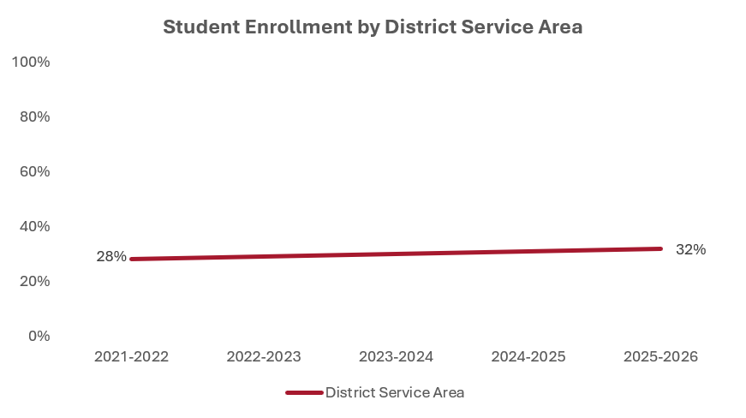
District enrollment is comprised of 32% of students who reside within the district service area.
All apportionment enrollments. District Service Area : Cupertino, Sunnyvale, Santa Clara (part of), San Jose (part of), Saratoga (part of), Los Altos, LA Hills, Mt. View, Palo Alto, Stanford

Slide 14
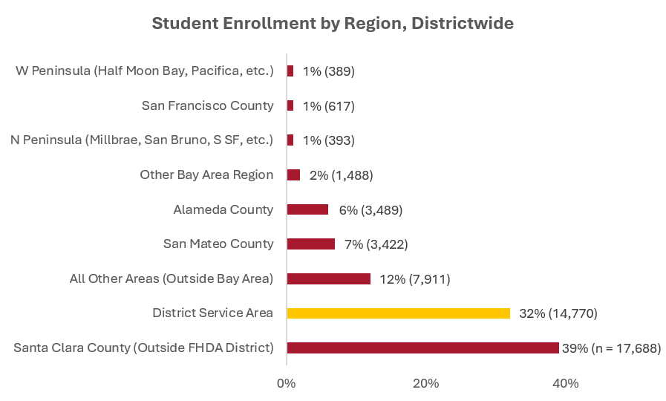
Nearly 40% of enrollment outside the district service area is within Santa Clara County.
All apportionment enrollments in 2025-26. N’s represent student headcount.

Slide 15
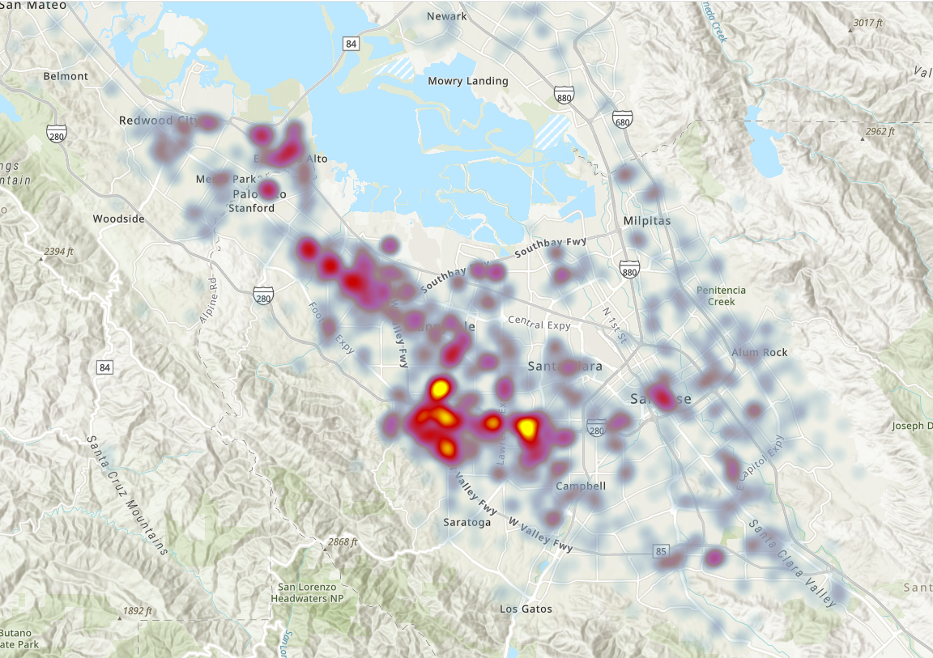
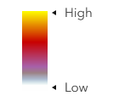
Student enrollment is concentrated across the south peninsula.
All apportionment enrollments in 2025-26.

Slide 16
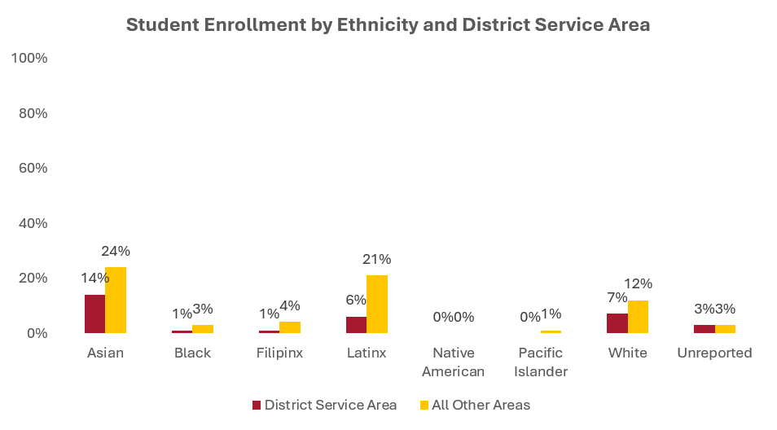
A greater proportion of students who identify as Asian, Black, Filipinx, and Latinx reside outside the district service area than within.
All apportionment enrollments in 2025-26. District Service Area : Cupertino, Sunnyvale, Santa Clara (part of), San Jose (part of), Saratoga (part of), Los Altos, LA Hills, Mt. View, Palo Alto, Stanford

Slide 17
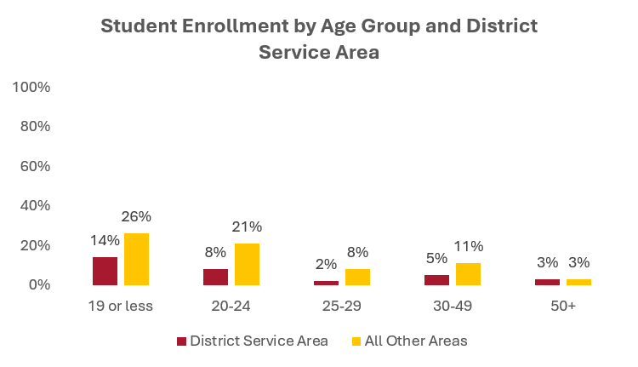
A large proportion of our students under 24 years of age reside outside the district service area.
All apportionment enrollments in 2025-26. District Service Area : Cupertino, Sunnyvale, Santa Clara (part of), San Jose (part of), Saratoga (part of), Los Altos, LA Hills, Mt. View, Palo Alto, Stanford

Slide 18
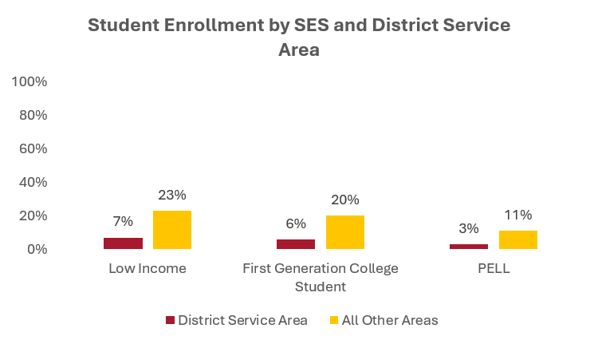
A higher rate of students who reside outside the district service area are low income, first gen and PELL recipients.
All apportionment enrollments in 2025-26. District Service Area : Cupertino, Sunnyvale, Santa Clara (part of), San Jose (part of), Saratoga (part of), Los Altos, LA Hills, Mt. View, Palo Alto, Stanford
Low income is defined as a family of 4 at $50,000. First generation no parent or guardian has any college experience. PELL is often used as an indicator for low income. Indicators are not mutually exclusive.

Slide 19
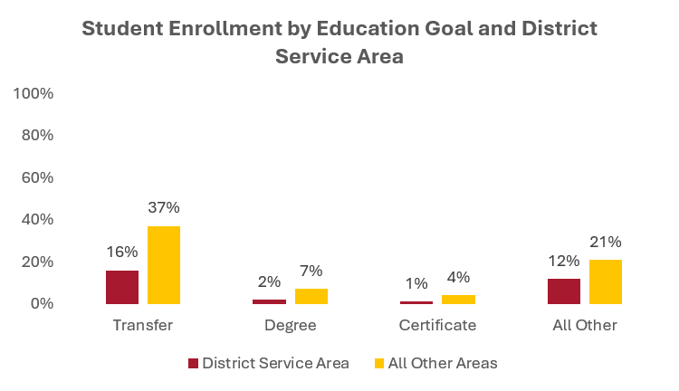
A larger proportion of our students with a transfer goal reside outside the district service area than within.
All other education goals includes career upskilling and personal enrichment.
All apportionment enrollments in 2025-26. District Service Area : Cupertino, Sunnyvale, Santa Clara (part of), San Jose (part of), Saratoga (part of), Los Altos, LA Hills, Mt. View, Palo Alto, Stanford

Slide 20
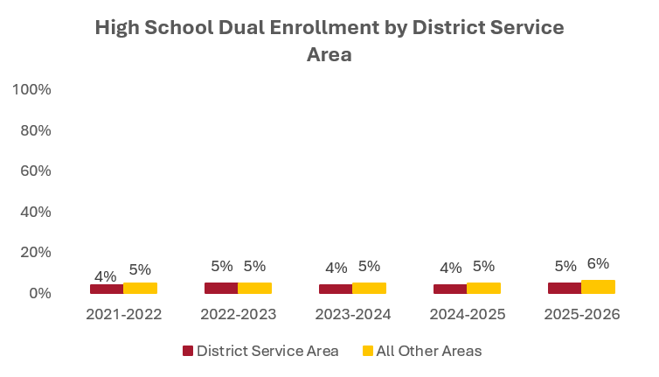
Dual enrolled high school are about equally distributed within and outside the district service area.
Dual enrollment high schools includes: Cupertino, Fremont, Homestead, Lynbrook, Monta Vista, Gunn, Palo Alto, Silver Creek, Mountain View,
Los Altos, Alta Vista, Freestyle Academy, East Palo Alto Academy, Menlo-Atherton, Sequoia, Woodside. All apportionment enrollments.

Slide 21
Enrollment Patterns by Modality

Slide 22
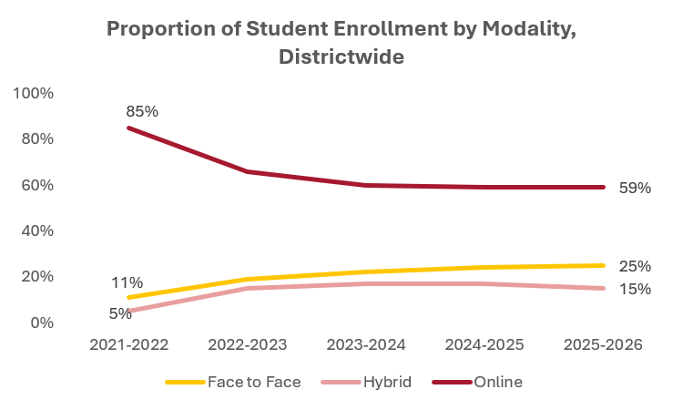
The proportion of enrollment in online courses has stabilized at 60% of total enrollments.
All apportionment enrollments.

Slide 23
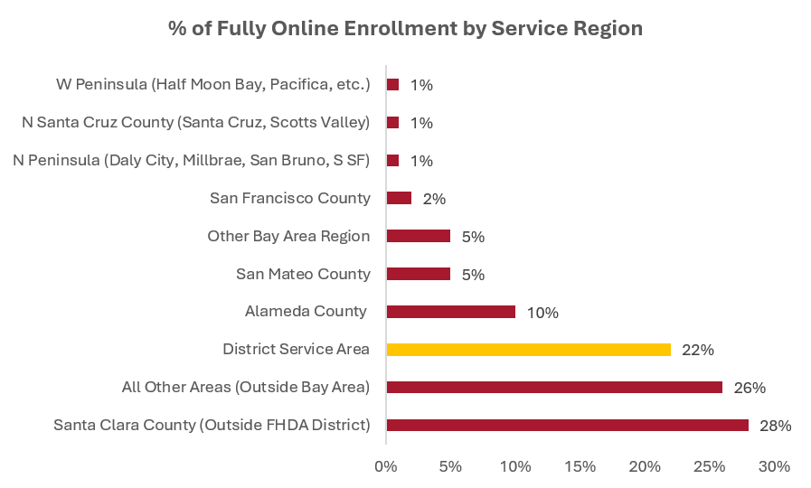
Of students enrolled fully online, 22% live within the district service area.
47% of districtwide enrollment is fully online
All apportionment enrollments in 2025-26. Represents students taking only online courses.

Slide 24
Enrollment Patterns by CTE

Slide 25
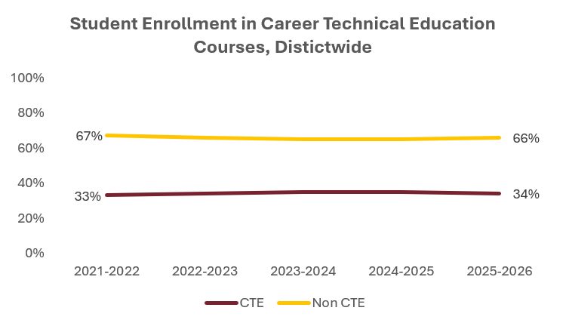
Career Technical Education (CTE) courses comprise a third of all enrollments districtwide.
All apportionment enrollments.

Slide 26
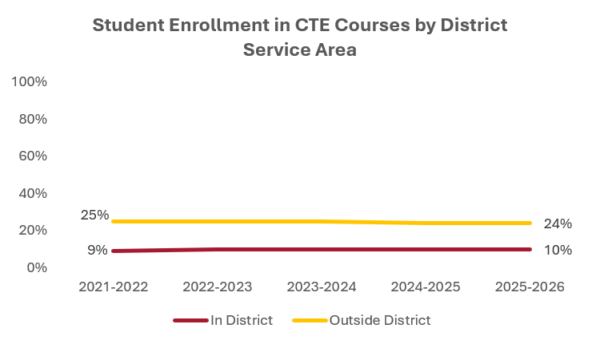
10% of CTE enrollment comes from within the district service area.
All apportionment enrollments in 2025-26. District Service Area : Cupertino, Sunnyvale, Santa Clara (part of), San Jose (part of), Saratoga (part of), Los Altos, LA Hills, Mt. View, Palo Alto, Stanford

Slide 27
Student
Outcomes

Slide 28
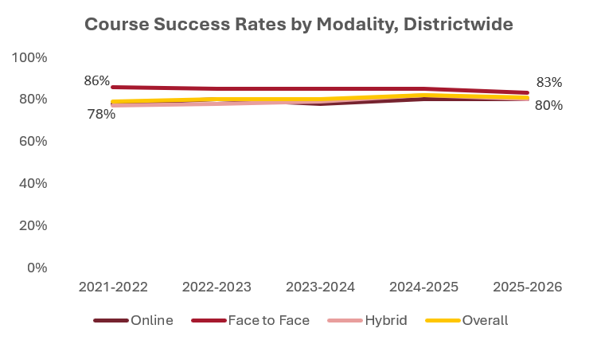
Gaps in course success have essentially closed between instructional modalities with success rates at 80%.
Credit sections. Enrollment reported for apportionment.

Slide 29
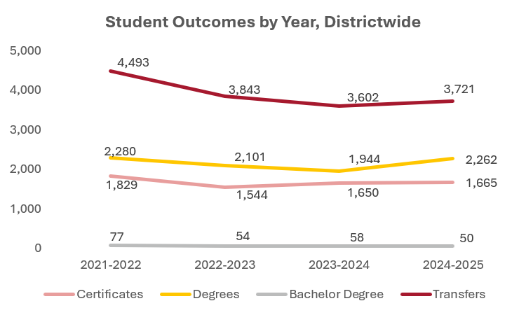
Transfer to four-year institutions drive student outcomes followed by associate degrees.

Slide 30
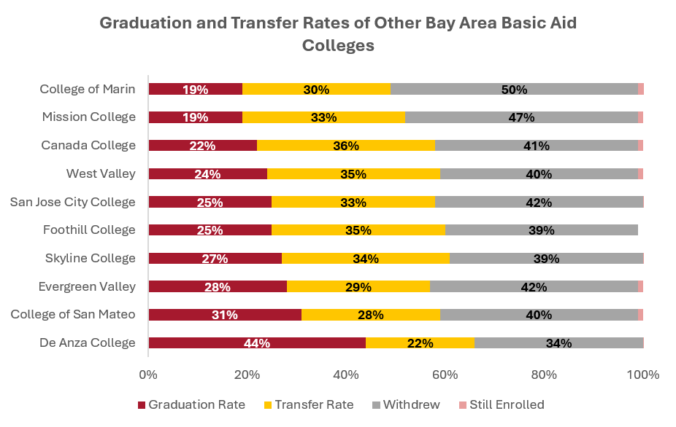
In comparison to other basic aid college completion rates, Foothill is above average while De Anza is at the top.
U.S. Department of Education Scorecard. Graduation and transfer rates are within 8 years of entry regardless of education goal.

Slide 31
TREND ANALYSIS

Slide 32
ENROLLMENT TRENDS

Slide 33
FTES Trends
Repeatability limits on classes took effect
Foothill-De Anza operating on Hold Harmless Funding under the SCFF
Basic Skills classes limits took effect (AB705)
Student Centered Funding Formula (SCFF) took effect)
Data Source: CCCCO 320 Report
*FTES – Full-Time Equivalent Students; R FTES – Resident FTES; NR FTES – Nonresident FTES

Slide 34
STAFFING TRENDS

Slide 35
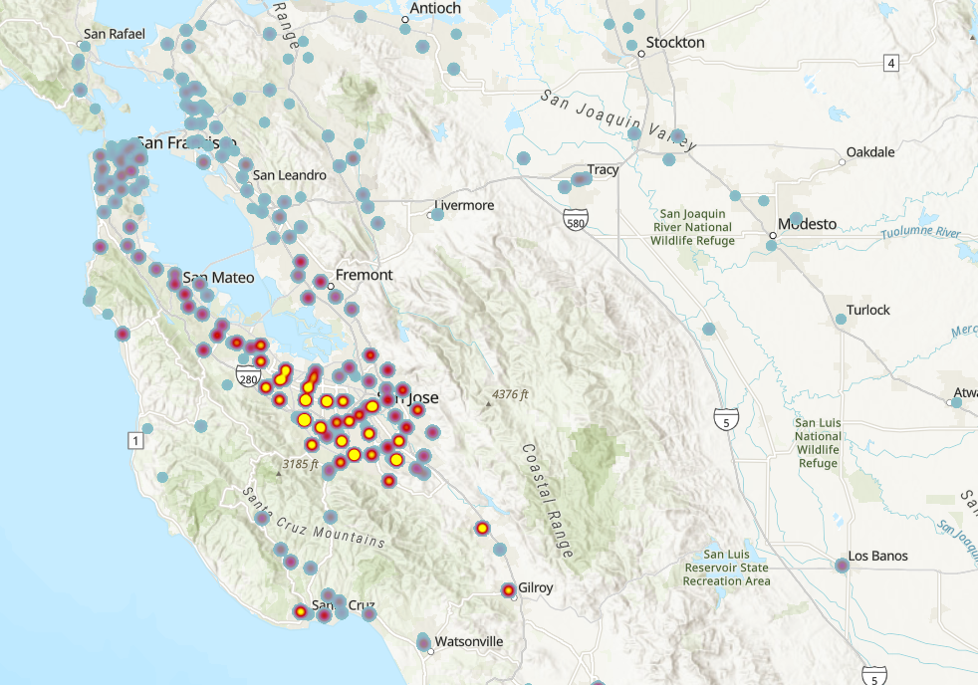
The majority of FHDA employees reside around the South Bay Area.
Employees in 2025-26. Excludes student employees and temporary employees.

Slide 36
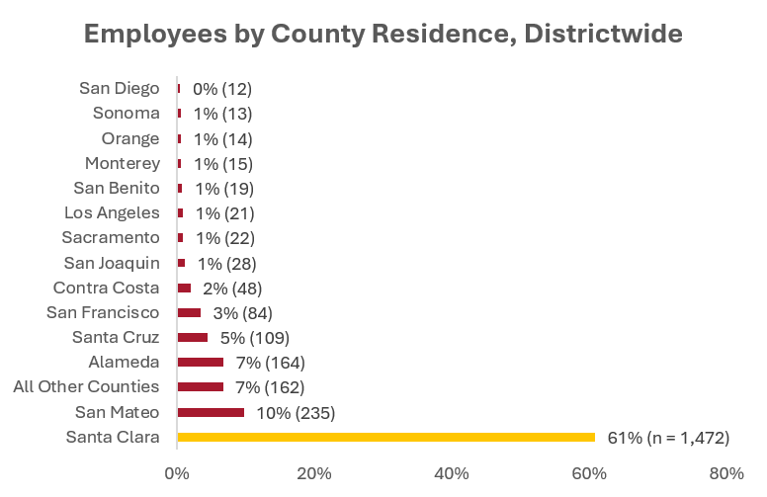
61% of FHDA employees reside within Santa Clara County.
Employees in 2025-26. Excludes student employees and temporary employees.

Slide 37
STAFFING TRENDS | FT & PT FACULTY (FTEF)
Data Source: CCCCO 320 Report; CCCCO Data Mart – Staffing (Fall Semester/Quarter)
*FT Faculty - Full-Time Faculty; PT Faculty – Part-Time Faculty; FTEF – Full-Time Equivalent Faculty

Slide 38
STAFFING TRENDS | CLASSIFIED (FTEE)
Data Source: CCCCO 320 Report; CCCCO Data Mart – Staffing (Fall Semester/Quarter)
*Classified Staff – Classified Support, Classified Professionals, Supervisors, Confidentials

Slide 39
STAFFING TRENDS | ADMINISTRATORS (FTEE)
Data Source: CCCCO 320 Report; CCCCO Data Mart – Staffing (Fall Semester/Quarter)
*Administrators – Educational (Certificated) and Classified Administrators

Slide 40
STAFFING TRENDS | RATIO PER FTES
Repeatability
AB 705/1705
COVID-19 Pandemic
Data Source: CCCCO 320 Report; CCCCO Data Mart – Staffing (Fall Semester/Quarter)

Slide 41
Silicon Valley
Regional Trends

Slide 42
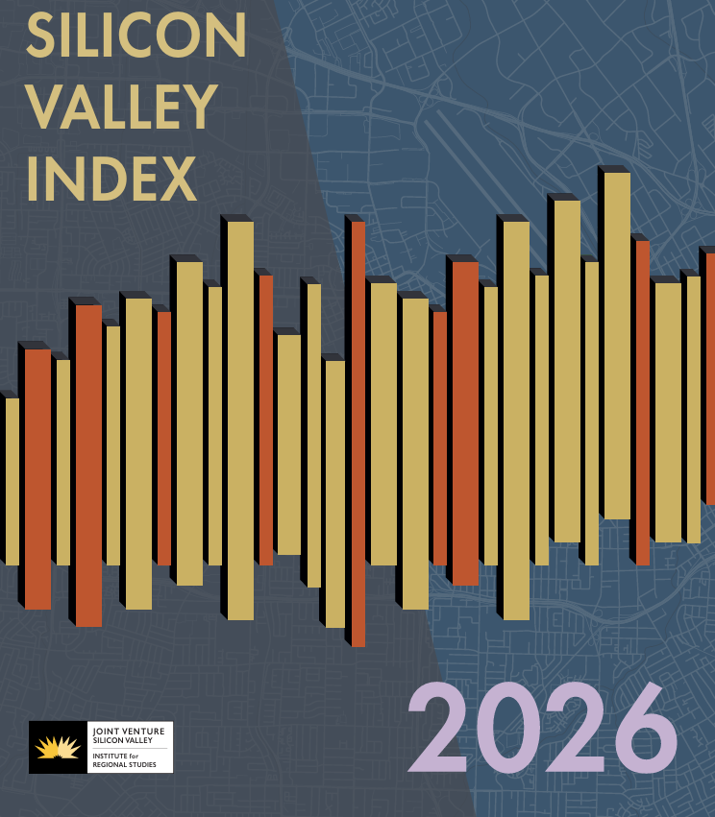
Silicon Valley Index
https://jointventure.org/download-the-2026-index

Slide 43
PEOPLE
Population holds steady; demographics are aging, global, and unevenly distributed
The region has added about 400,000 residents since the mid-1990s and returned to roughly its mid-2020 population level by 2025, with growth driven primarily by migration.
Domestic outmigration continues, offset by sustained international immigration, reinforcing global ties while reshaping local demographics.
The 65+ population has grown 29% since 2014, while children under 18 have declined 15%, reflecting falling birth rates.
About 40% of residents are foreign-born and over half speak a language other than English at home. White residents total 44% (alone or in combination), while Asian residents make up 39% alone (42% alone or in combination), with demographic clustering persisting across communities.

Slide 44
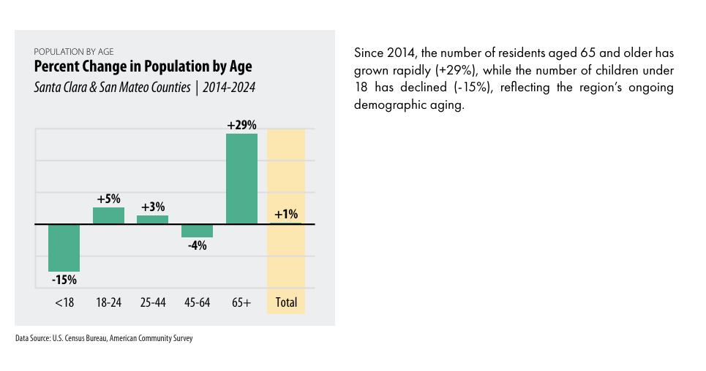
Percent Change in Population by Age

Slide 45
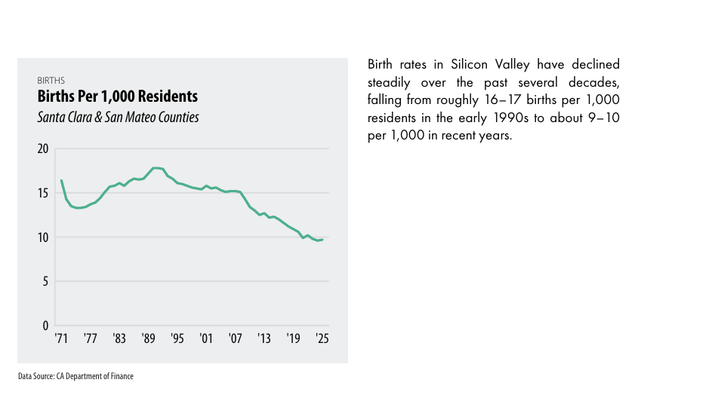
Births per 1,000 Residents

Slide 46
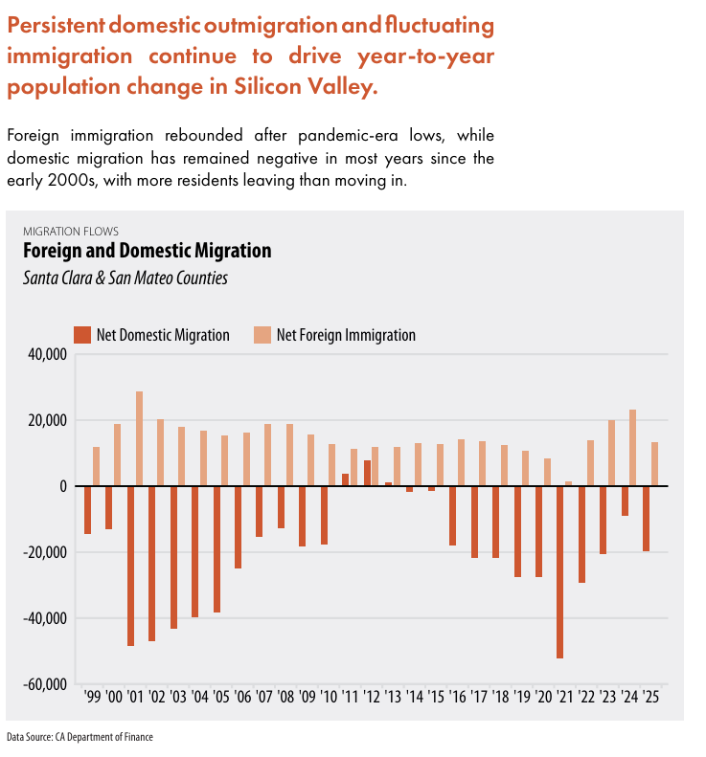
Foreign and Domestic Migration

Slide 47
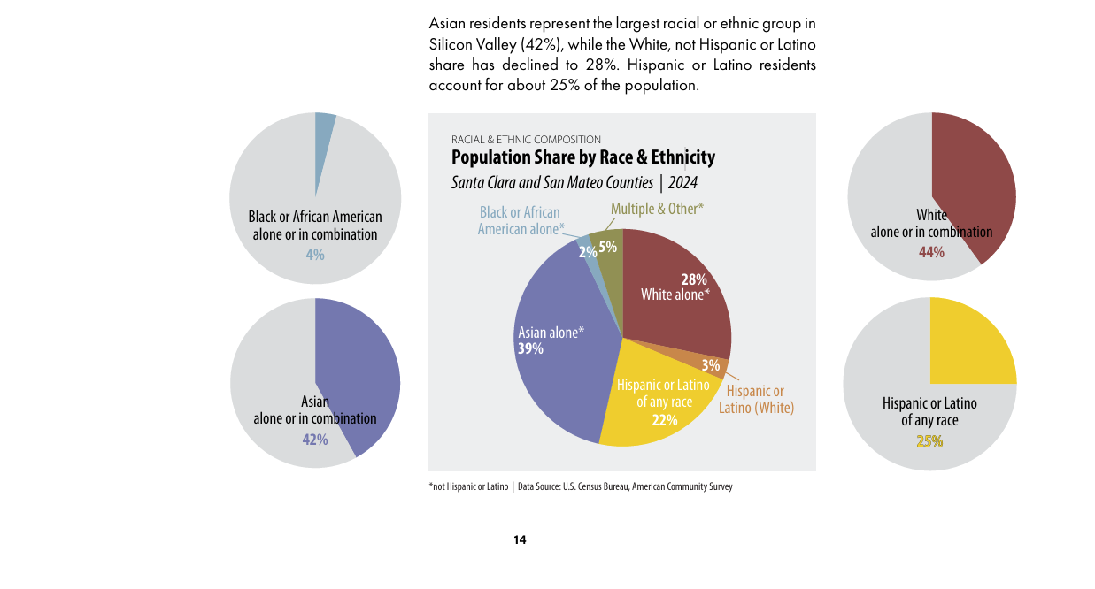
Population Share by Race and Ethnicity

Slide 48
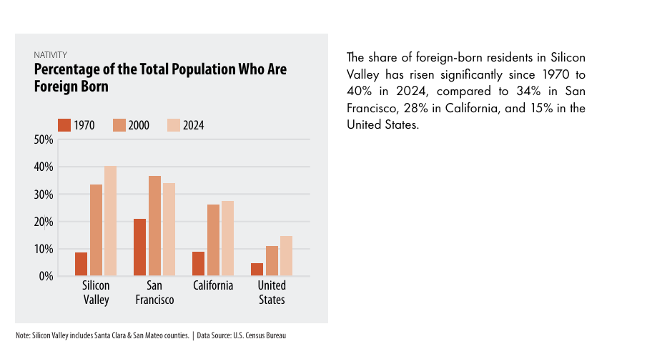
Percentage of the Total Population Who are Foreign Born

Slide 49

EMPLOYMENT
Jobs plateau, but tech holds strong
Total employment remains slightly above pre-pandemic levels but declined by 13,100 jobs (−0.8%) between mid-2024 and mid-2025, with little net growth since 2022.
Healthcare, goods movement, and internet/information services exceed pre-pandemic levels, while construction, retail, and personal services remain below.
Since the Great Recession low, Silicon Valley employment has grown 32%, outpacing California and the nation, driven largely by tech.
Software developers (about 140,000) and engineers (approximately 84,000) are the largest occupational groups in Silicon Valley; the 20 largest tech firms employ about 215,000 workers (9% of the workforce), even as local headcounts decline amid global expansion.
Remote and hybrid work remain elevated, with employees working from home 31% of the time, and an estimated 410,000 jobs involve tasks AI can now perform, signaling potential restructuring.
Office vacancy reached 22% and lab 35%, asking rents declined, leasing hit its highest level since 2018, and five major tech firms occupy more than 55 million square feet of office and R&D space.

Slide 50
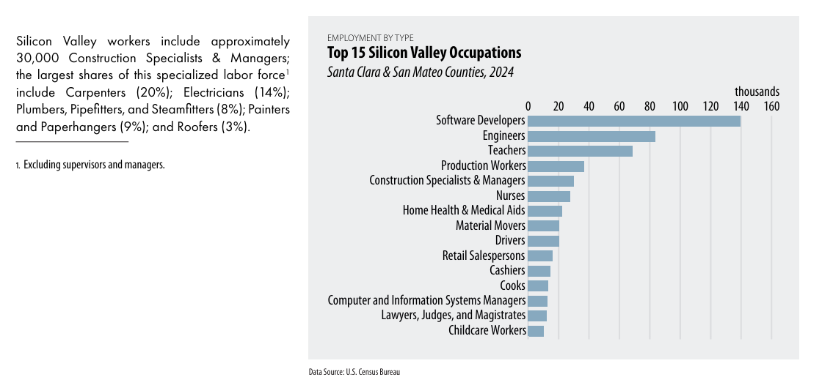
Top 15 Silicon Valley Occupations

Slide 51
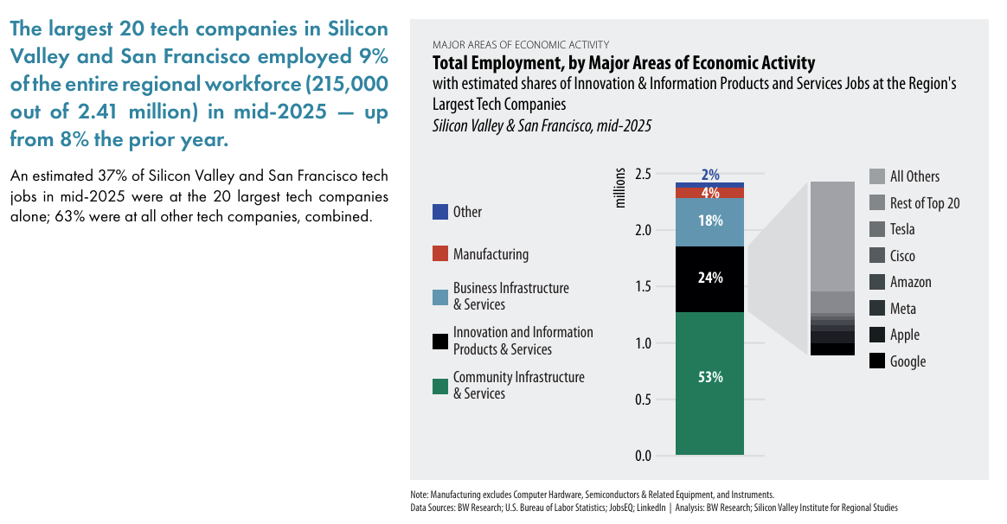
Total Employment, by Major Areas of Economic Activity

Slide 52
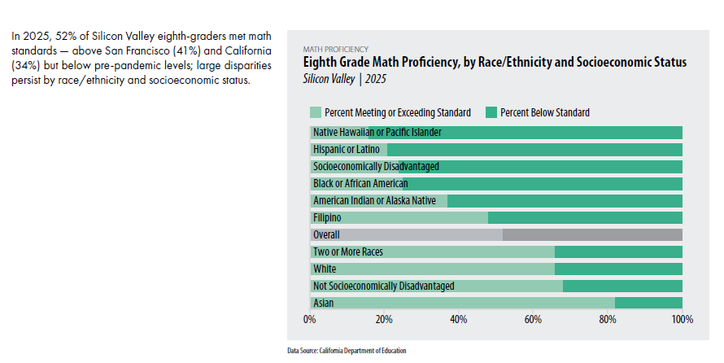
8th grade math proficiency

Slide 53
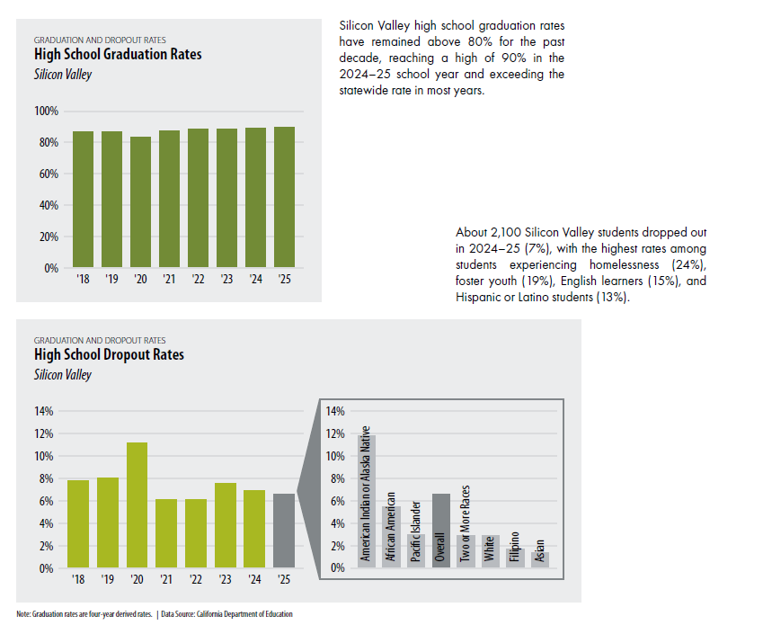
High School Graduation Rates

Slide 54
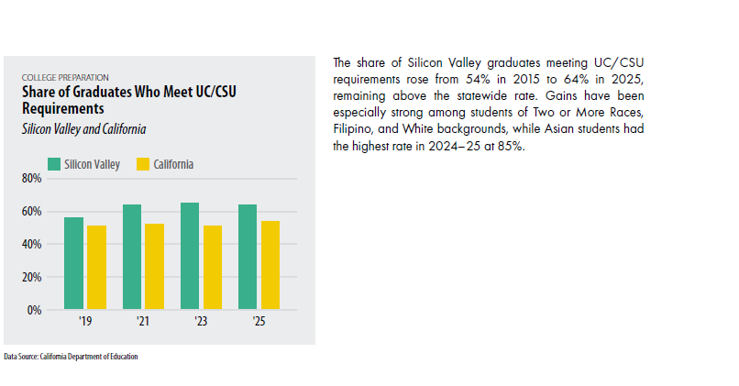
Share of Graduates who meet UC/CSU Requirements

Slide 55
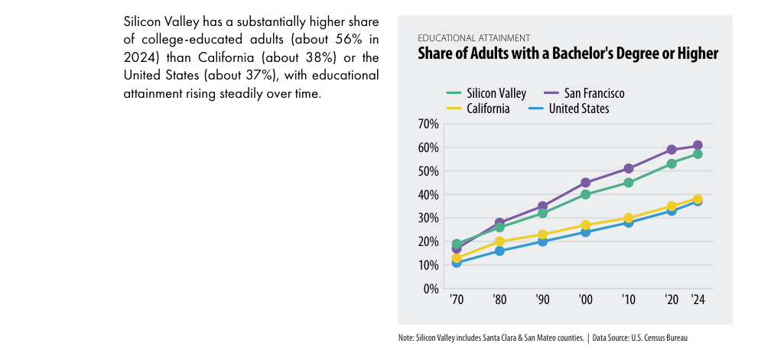
Share of Adults with a BA Degree or Higher

Slide 56
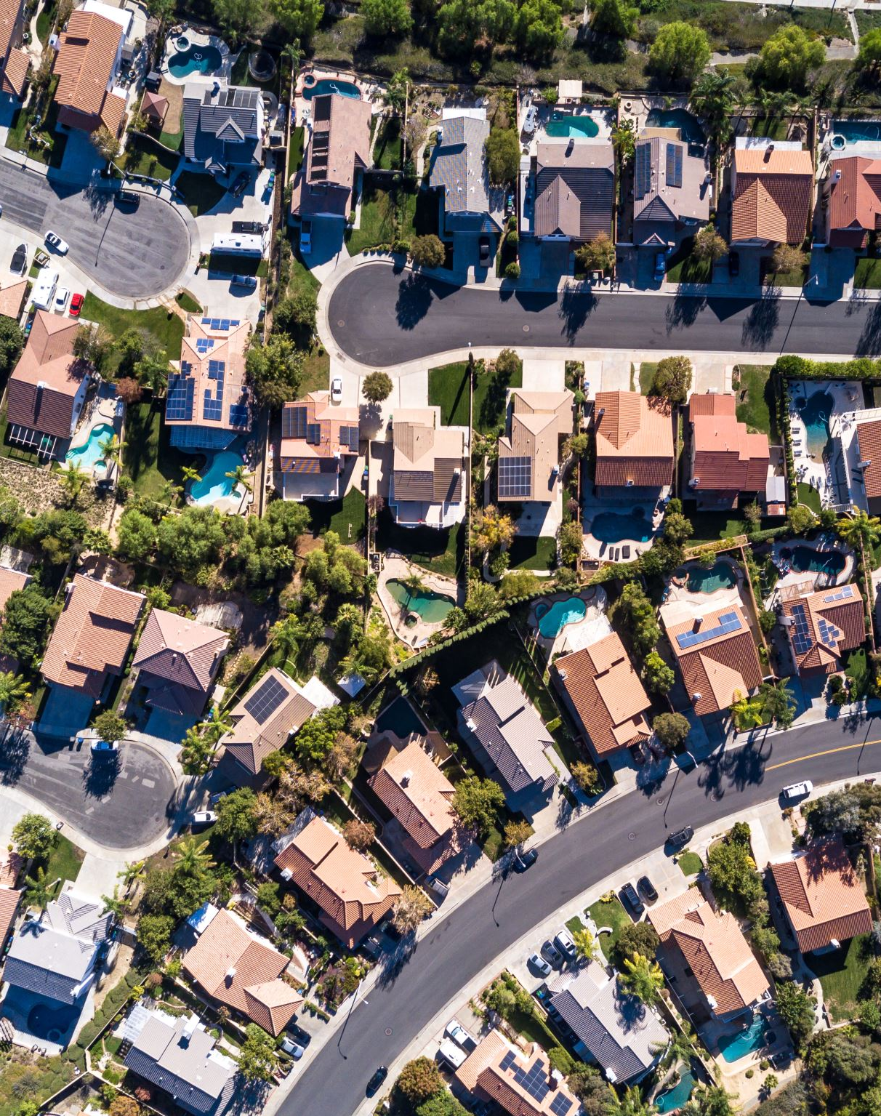
Housing
Skyrocketing costs decide who can live in the Valley
The median single-family home price reached $1.98 million in 2025, with over half of homes selling above $2 million. Only about 25% of first-time buyers could afford a median-priced home.
Rental burdens remain high: 44% of renters are cost-burdened, and 21% spend more than 50% of income on housing.
Housing pressures influence living arrangements: 3 in 10 young adults live with parents, and 1 in 4 residents live in multigenerational households.
Homelessness remains a critical challenge, with roughly 12,900 unhoused individuals in 2025, including rising numbers of families with children and chronic cases.

Slide 57
Contacts
Gohar Momjian, momjiangohar@fhda.edu
Christopher Dela Rosa, delarosachristopher@fhda.edu
Mallory Newell, newellmallory@fhda.edu

