Slide 1
MIS STUDENT DISABILITIES (SD) Report at fhda: Introduction to methods & Procedures
Foothill-de anza community college district
institutional research & planning
October 15, 2020

Slide 2
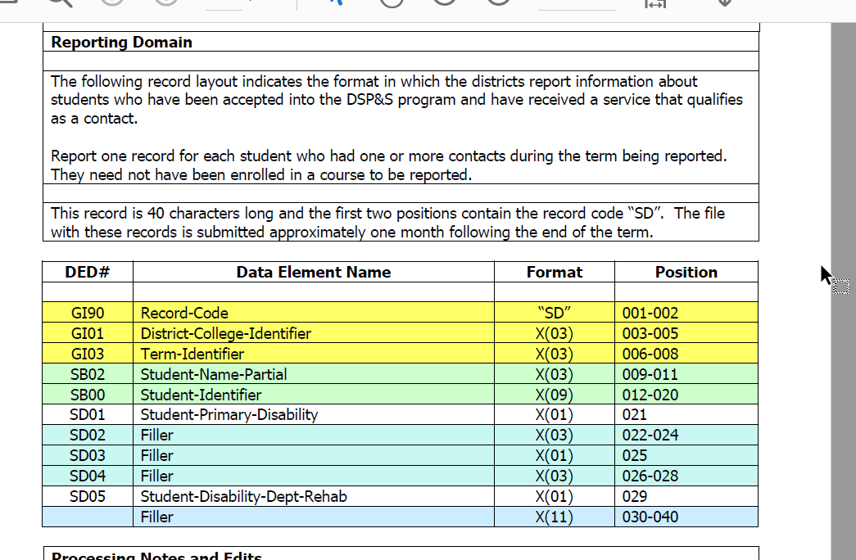
MIS SD Report, MIS DED

Slide 3
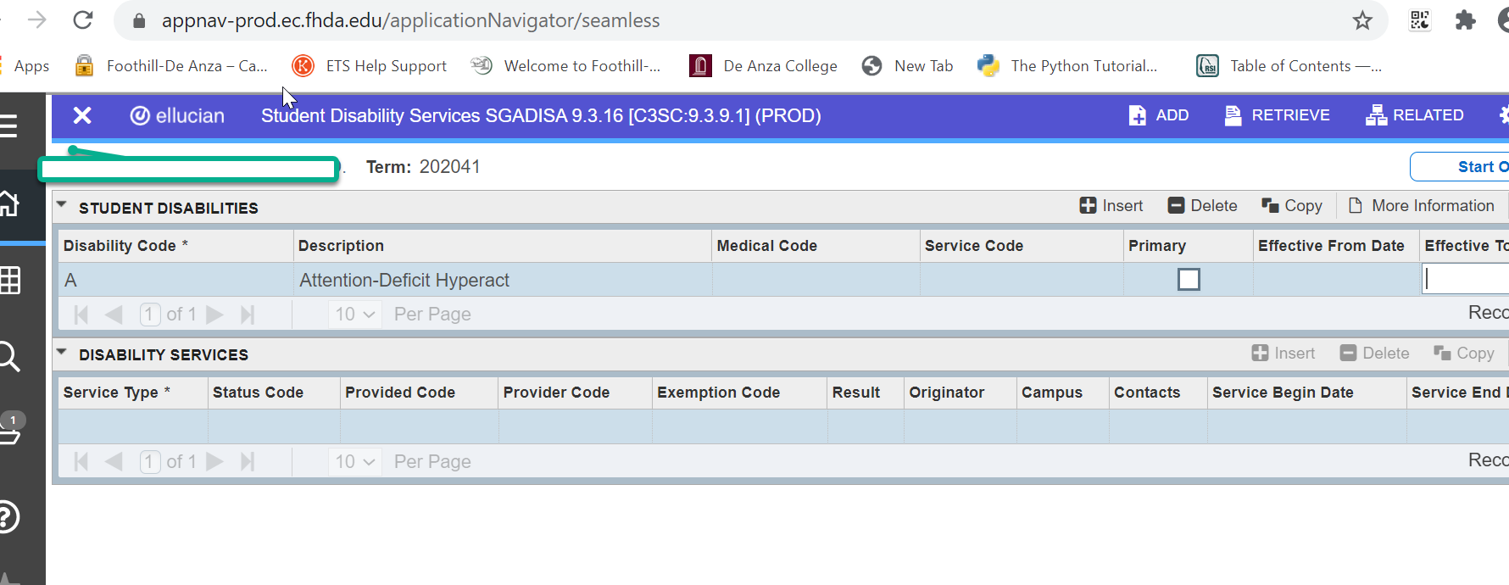
SGADISA, Banner

Slide 4
SGADISA Data Sources at FHDA
Clockwork
Disability Codes
Contacts/Services
SARS
Scheduled appointments/Services
Courses
Note: Data for services/contact hours can only be uploaded/inserted for students with at least one disability code in SGADISA for the term.

Slide 5
MIS SD Data Clean-up: preliminary steps & argos reports
Upload Disability Codes from Clockwork to SGADISA
Run Argos Prelim Reports (SARS, Courses, positive attendance)
Upload Service Hours to SGADISA
Note: Preliminary Argos reports identify students who for the reporting term: (a) enrolled in at least one DSPS course or have a scheduled appointment in SARS (b) and do not have a disability code in SGADISA or is classified as NC (not claimable) for the academic year.

Slide 6
Argos Reports for DSPS Foothill College
Courses: Students enrolled in at least one DSPS courses missing the data for disability code in SGADISA
SARS: Students enrolled in at least one DSPS courses missing the data for disability code in SGADISA
Sections for DSPS courses missing positive attendance hours
Students in SGADISA with services for the term, but not enrolled by census (not enrolled, but claimable)
Master List
Note: Argos reports are sent by email, at least one a week during data cleanup period (three to four weeks prior submission).

Slide 7
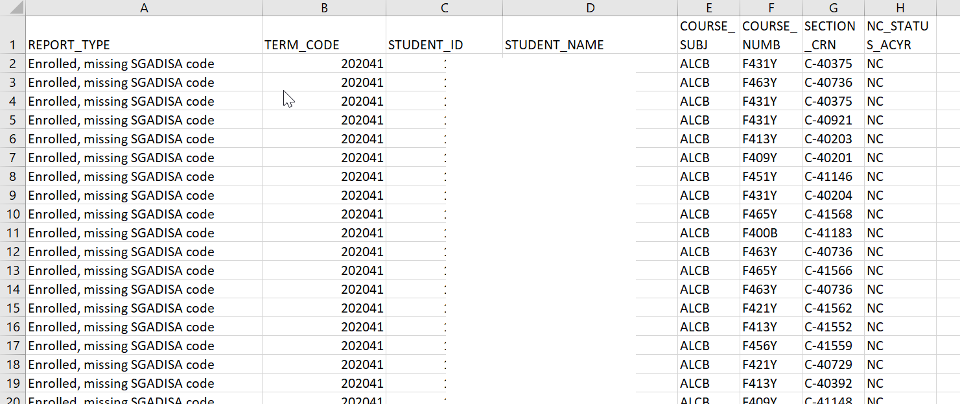
Argos Reports, Courses

Slide 8
Final Steps Prior Submission
Account for every student in Clockwork, SARS, DSPS Courses
Send email to give “go ahead” to upload contact hours to SGADISA
Review “Master List” and send email with final headcount
Note: Data in the master list need to be confirmed prior submission.

Slide 9
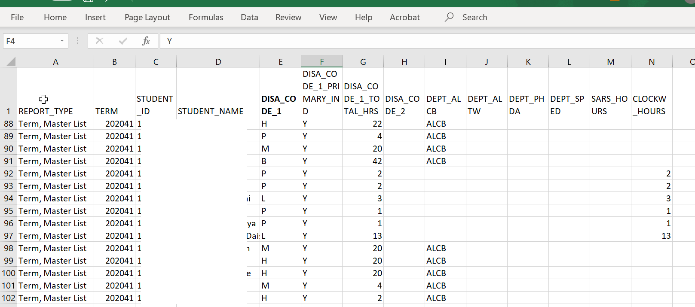
Argos Reports, Master List

Slide 10
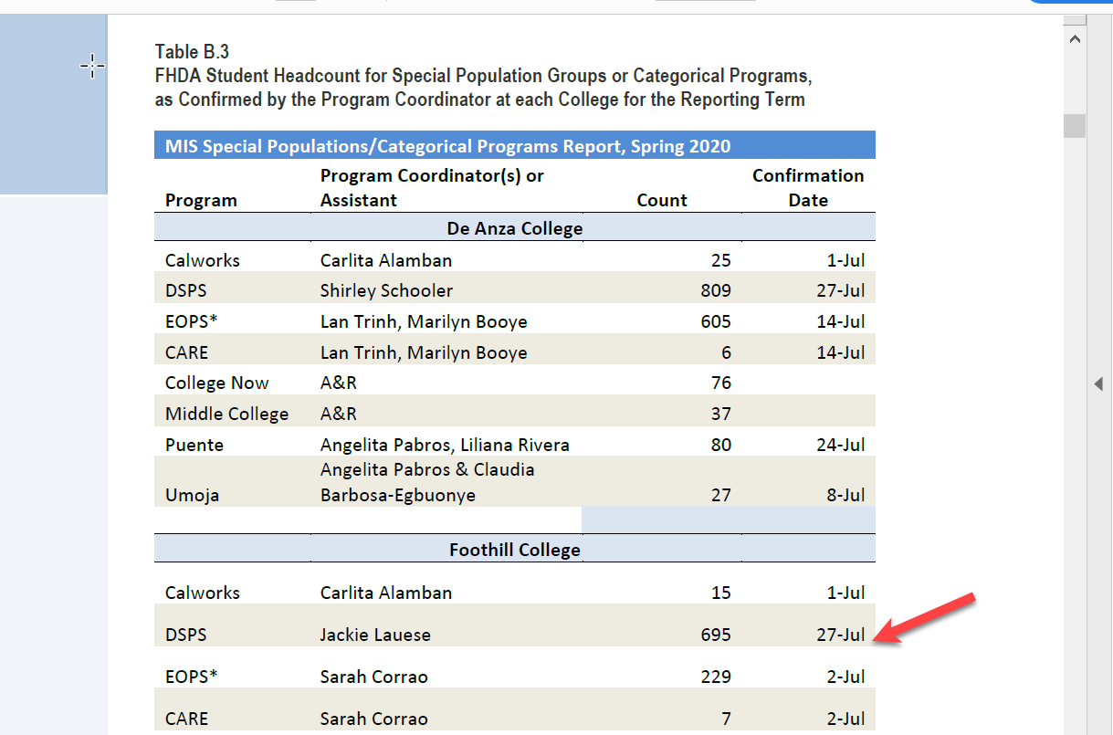
FHDA MIS Quarterly Submission Reports
http://research.fhda.edu/mis_reports/mis_quarterly_submssion_report/

Slide 11
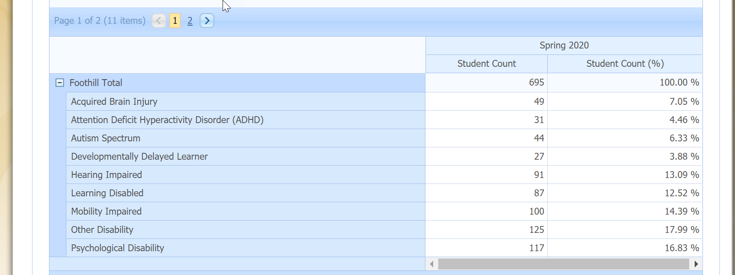
MIS Data MART, CCCCO
Notes: Review several reports available at the data mart, https://datamart.cccco.edu/Services/DSPS_Status.aspx

Slide 12
Final points
Data in Clockwork should be up-to-date; otherwise, your department will need to manually insert data in Banner-SGADISA and Clockwork.
Do not ignore emails; these are meant to help your department submit accurate data on time.
The master list must be confirmed through email prior submission date.
MIS data cleanup begins a month after end of reporting term. Cleanup reports run from three to four weeks prior submission.
MIS data resubmissions for summer, fall, and winter are in June/July (purpose: to fix any errors in the original submission).
Become very familiar with MIS Data Mart. This is a great resource for data checks and program review.

