Slide 1
MIS Special Populations (SG) MESA
Data Cleanup Methods & Procedures
Lourdes del Rio-Parent, FHDA CCD
January 2024

Slide 2
California Community Colleges Chancellor’s Office MIS Reports
DSPS (SD)
CalWORKs (CW/SC)
Student Basic
(SB)
EOPS (SD)
Special Pop (SG)
Prior Learning (SY)
VTEA/CTE (SV)
Fin Aid (SF/FA)
Success-3SP (SS)
Courses (CB)
Acad Awards (SP)
Class Enrollment (SX)
Sections (XB)
Placement (SL)
Sessions (XF)
Academic Calendar (CC)
Faculty Assignment (XF)
Assessment (SA)
Employee Demographics (EB)
Employee Assignment (EJ)
Notes
Overlap shows dependency between reports.
A version of the employee demographic report (EB) is used for full and part-time faculty in the quarterly reports.
Blue identifies quarterly reports; orange, annual reports.

Slide 3
FHDA MIS SG Special Populations, Dependencies
At FHDA, most special population group students need to also show registration by census date.
Student Basic
(SB)
Special Pop (SG)
Class Enrollment (SX)
Notes
Overlap shows dependency between reports.

Slide 4
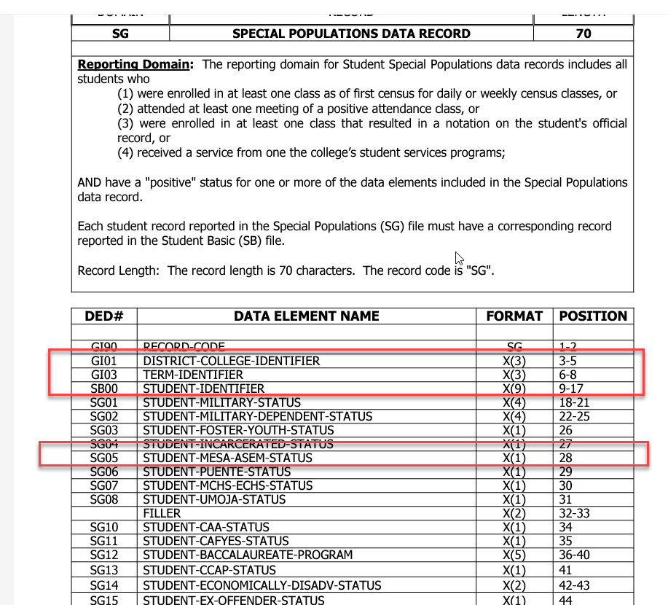
MIS SG Special Populations, Domain
The report is a text file, which, among other things, identifies the college, the academic period, student ID and status for each special population group, including MESA status.
The identifiers (college, term, student ID) allow reports to be linked.

Slide 5
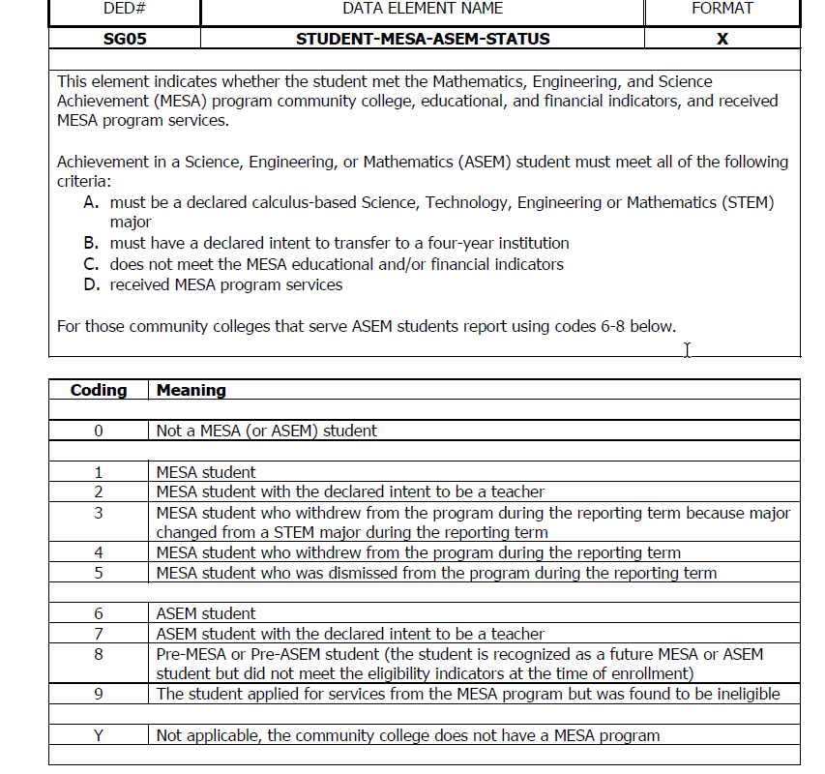
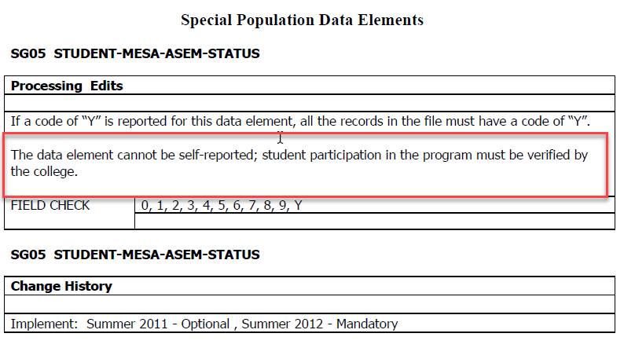
SG05 MESA-ASEM Status
Data will only be submitted after the list of participating students are confirmed by the college (e.g., program coordinator).

Slide 6
Special Populations Data Cleanup
Banner-SGASADD
MIS SG Rep (Confirmed Data)
Banner-SGASADD shows data entered/maintained by the college/program
MIS SG Rep is a table that keeps track of data that has been confirmed by the college (i.e., beginning and end term of student’s participation in the program; reason for withdraw or disqualification).
This is the data submitted in the MIS SG report.

Slide 7
Discussion: Data entered in Banner and Assigned Data Custodians
MIS Code & Meaning
0 - Not a MESA (or ASEM) student (Default, no need to code this.)
1 - MESA student (Banner-SGASADD)
2 - MESA student with the declared intent to be a teacher (Banner-SGASADD, cohort?)
3 - MESA student who withdrew from the program during the reporting term
because major changed from a STEM major during the reporting term (MIS SG REP)
4 - MESA student who withdrew from the program during the reporting term (MIS SG REP)
5 - MESA student who was dismissed from the program during the reporting (MIS SG REP)
6 - ASEM student (Banner-SGASADD)
7 - ASEM student with the declared intent to be a teacher (Banner-SGASADD, cohort?)
8 - Pre-MESA or Pre-ASEM student (the student is recognized as a future (Banner-SGASADD)
9 - The student applied for services from the MESA program but was found to be ineligible (Banner-SGASADD)
Y - Not applicable, the community college does not have a MESA program (N/A to FHDA)

Slide 8
Discussion: Data entered in Banner and Assigned Data Custodians (cont.)
Does the program provide services in the summer?
What Banner form and data fields are being used to enter the data?
MESAFH (Mesa Program Foothill)
How about “MESA student with the declared intent to be a teacher”?
Is this applicable to Foothill? If yes, need a new code in Banner.
Who enters/maintains data in Banner?
SARS data
What codes are used in SARS to identify counseling/advising services?

Slide 9
Data Cleanup: Argos Reports
MIS SG Mesa, Argos Report 1
Scheduled to run once a week for at least three weeks prior submission date. For students registered by census date during the reporting term and who (a) were previously identified as MESA students or (b) are shown to be active in the program during the reporting term based on Banner-SGASADD data.
The report is a CSV document sent by email, which includes:
COLLEGE
ACADEMIC_PERIOD
MIS_STATUS (whether participation in the program has been previously confirmed)
COHORT_CODE (Banner code, if available)
COHORT_TERM (Effective term for Banner code)
STUDENT_ID
LAST_NAME
FIRST_NAME
SG_END_TERM (whether participation in the program has been previously terminated or ended)
SG_END_REASON (Reason for ending program participation
REG_CREDITS_TERM (Number of credits units registered during the term by census date)

Slide 10
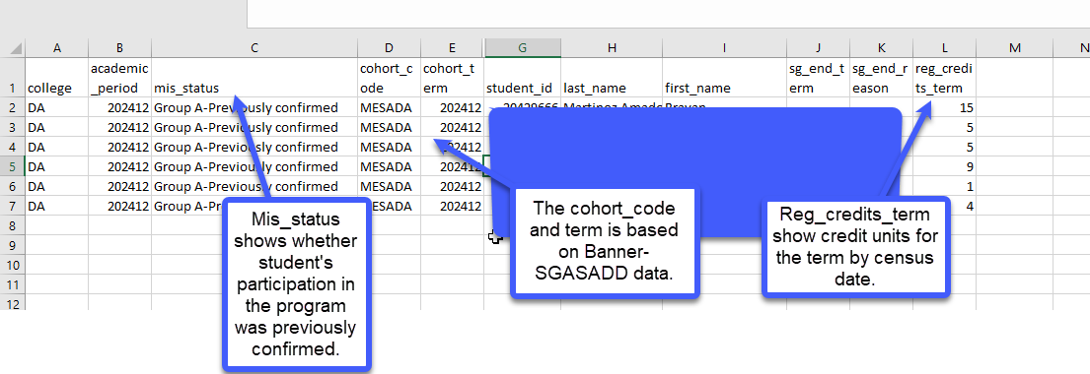
Data Cleanup: Argos MESA Report 1

Slide 11
Data Cleanup: Argos Reports
MIS SG Mesa, Argos Report 2
For students in report 1, this report shows SARS data for the reporting term and related MESA location(s). The report is designed to help identify students served during by the program during the reporting term.
The report is a CSV document sent by email, which includes information from report 1 and the following data from SARS:
SARS_COUNSELOR_SHORTNAME
SARS_COUNSELOR_TITLE
SARS_LOCATION_CODE
SARS_LOCATION_DESCRIPTION
SARS_REASON_DESC
SARS_SCHEDULED_DT

Slide 12
Data Cleanup: Argos MESA Report 2

Slide 13
MIS SG05 Data Cleanup and Submission, Review
Program coordinator or assistant enters data in Banner
Run Argos data cleanup report to review MESA status for registered students (new or previously confirmed).
Update Banner and MIS SG Rep as needed.
Confirmed student list/headcount.
MIS quarterly reports are submitted. Any pending issues and the confirmed headcount are documented in the submission report.

Slide 14
MIS Quarterly Submission Report
Summary reports for the data submitted, including data validity issues, are available at:
https://research.fhda.edu/mis_reports/mis_quarterly_submssion_report/

Slide 15
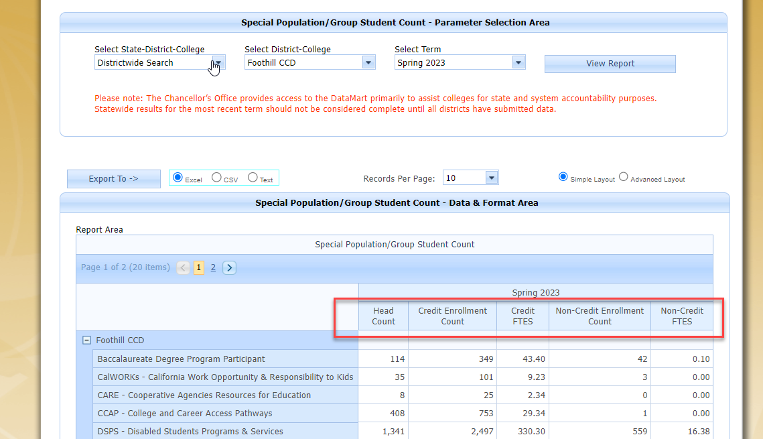
MIS Data Mart, Special Populations
https://datamart.cccco.edu/Services/Special_Pop_Count.aspx
Question: How is the MIS data mart able to provide statistics about student enrollment in credit and noncredit courses by program or special population?

