Slide 1
MIS SP Student Program Award FHDA CCD Data Cleanup Methods & Procedures
Lourdes del Rio-Parent, PhD
Senior Research Analyst
Institutional Research & Planning
Foothill-De Anza CCD
March 2024

Slide 2
Goal and objectives
Provide an overview of methods and procedures used by the FHDA CCD for data cleanup and submission of the MIS SP (Student Program Award) report.
Identify data fields submitted in the report
Identify data sources used for the data cleanup of credit and noncredit awards
Illustrate main steps of the data cleanup and submission process
Identify technologies used for data cleanup and submission
Identify resources available to data custodians to review the data submitted and resolve any errors or issues prior data resubmission

Slide 3
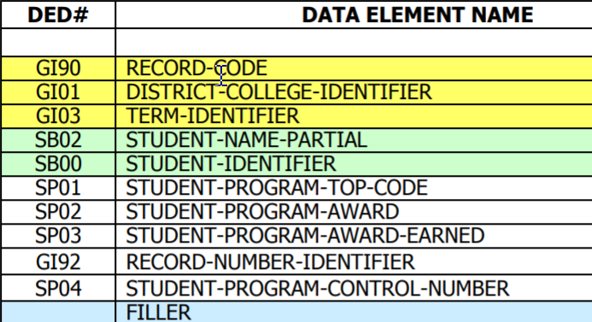
Data submitted in the MIS SP report
Identifier for the college, submission year, and student (SSN or campus wide ID)
TOP code for the program (i.e., major or area of studies)
Award code (i.e., type of degree, certificate, and units/hours)
Award unique code (control number)
Date of award
Notes:
The purpose of the MIS SP report is to identify students who were awarded at least one degree or certificate at the college during the reporting academic year. The report also identifies the program of studies (e.g., major), award type (e.g., approved credit certificate of at least 27 quarter units), the control number (i.e., a link to COCI or CCC Curriculum Inventory) and the date for the award. The report is submitted annually, usually in mid-`September.

Slide 4
Relationship between MIS SP and other MIS reports or data sets
CCC COCI
MIS Quarterly Reports
MIS Student Identifier Update
MIS SP Academic Awards
Notes:
Prior to the submission of MIS SP (student program award), all MIS quarterly submissions for the academic year should have been submitted. Any record in MIS SP with a student ID not previously submitted in the MIS SB report (one of the quarterly reports) will be rejected. To avoid rejection due to a student ID change, the MIS SI update report, which identifies changes for previously submitted student IDs, should be submitted prior to submitting MIS SP. Award data in MIS SP (TOP code, award type, control number for each degree and certificate) must not show any discrepancies with data for the award in COCI. COCI is the CCC (California Community College) curriculum inventory, which includes data for all degrees and certificates approved for each college.

Slide 5
The zero error tolerance rule
Notes:
The CCC data systems (which includes COCI and MIS) can be viewed as subsets of a larger system with zero tolerance for discrepancies across data sets. The MIS SP must show no discrepancy with the MIS program master file (data from COCI which identifies all approved programs at the colleges using TOP and Unique codes) or the MIS SB report (MIS quarterly report with identifiers for all students at the college during a term).

Slide 6
Identifying data discrepancies among the college catalog, COCI and Banner data
SQL scripts are used to identify data discrepancies between COCI and Banner.
These discrepancies are resolved by the data custodian at the college based on information from the college catalog for the upcoming academic year (e.g., title, number of credit units or hours, missing programs).
Catalog
COCI
Banner
Notes:
The data cleanup for program data (data for degrees and certificates offered at the college during the academic year) begins in summer and relates to data for the upcoming academic year (about a year in advance of data submission for the academic year). The final reports resulting from this data cleanup (one Excel file for each college) are available at the FHDA IRP MIS website, https://research.fhda.edu/mis_reports/mis_sp_program_awards, under the heading MIS SP (Academic Awards) Data Cleanup Reports.

Slide 7
Identifying data discrepancies among the college catalog, COCI and Banner data (cont.)
Notes:
The report (an Excel file) is used by data custodians (academic program coordinators) to compare data in Banner and COCI. Using separate worksheets, the report identifies awards (degree or certificate) with any of the following issues: (1) not approved by COCI, (2) with discrepancies regarding TOP and unique code, (3) different MIS award code, and (4) duplicated unique code. The report also allows the data custodian to review award titles across system. Regarding noncredit certificates, the report identifies all approved certificates and required courses.

Slide 8
MIS SP-Credit awards, data sources
MIS SP SQL Views
Banner-SMRPRLE (describes degrees & certificates)
Banner-SHRDGMR (identifies students and the academic awards they received during the academic year)
COCI Program Inventory (identifies approved degrees & certificates)
College Catalog
Notes:
Data from COCI (CCC program inventory) should reflect data from the college catalog for the reporting academic year. Data extracts from COCI are used to assess the accuracy and completeness of the data in Banner for programs offered at the college during the reporting year (e.g., SMRPRLE, STVMAJR). Once the data in Banner shows no error, an SQL view is used to link data from Banner tables to extract the data for the report on the submission date.

Slide 9
MIS SP-Credit awards, data cleanup
Update MIS SP SQL views
Run MIS SP discrepancy reports
Send discrepancy reports to evaluators
Evaluators modify/update data in Banner or COCI, if needed.
Notes:
At least three weeks prior to the submission date, the MIS SP discrepancy report is emailed to data custodians at the colleges. The reports are run until no discrepancies are found or submission date.

Slide 10
MIS SP-Credit awards, data cleanup (cont.)
The MIS SP data cleanup/discrepancy report is used to identify MIS edits (e.g., syntactical, referential) prior submitting data to the MIS system.
The data cleanup process (i.e., discrepancy report and resolutions) should help…
avoid or explain discrepancies between data used for institutional/local reports and that submitted in MIS SP
provide user-friendly and more meaningful reports to data custodians than those generated by the MIS CCCCO system.
facilitate data submission (i.e., most issues are resolved prior submission date).

Slide 11
MIS SP-Credit awards, data cleanup (cont.)
The MIS SP data cleanup/discrepancy report is an Excel document with worksheets that include the following:
discrepancies between date and term for the award (i.e., award term and award date do not match)
discrepancies with COCI (e.g., the top code-unique code combination for the degree or approved certificate is not included in COCI)
students with duplicated awards (i.e., multiple records for the student with same degree or certificate)
summary statistics by award type to check on counts for the prior and current reporting year and identify unexpected changes
summary statistics by program (i.e., award type and major) to check on counts for the prior and current reporting year and identify unexpected changes

Slide 12
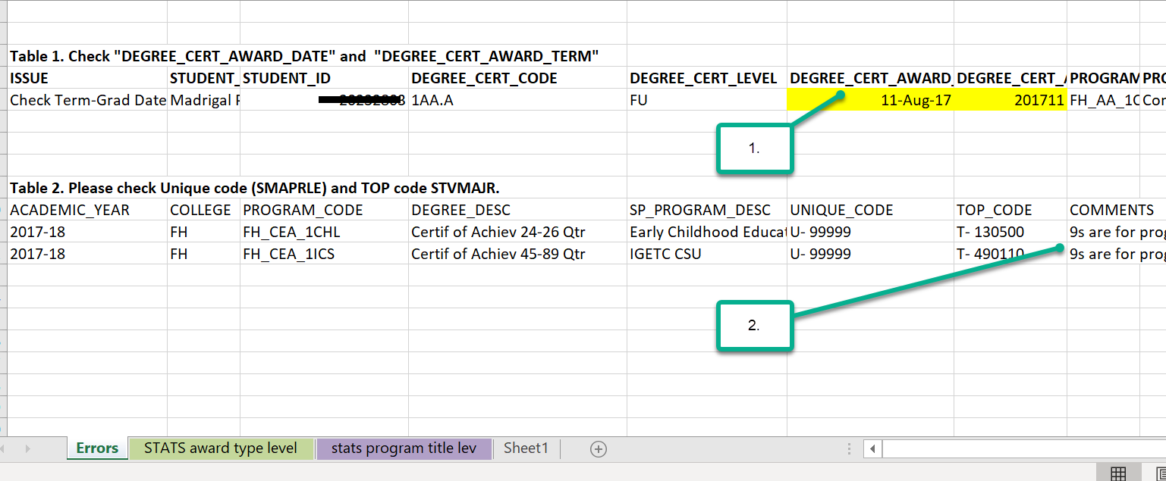
MIS SP-Credit awards, data cleanup report
Notes:
This screenshot of this MIS SP data cleanup/discrepancy report for the 2018 academic year shows two type of errors. For number #1, the term code “201711” is for the summer term of the 2017 academic year; however, the date, August 2017, is for summer of the 2018 academic year. For #2, the issue is that ‘99999’ are only used for credit certificates not approved by the CCCCO. It is possible that FH_CEA_1CHL was not approved; however, the data custodian is just asked to verify that this is the case.

Slide 13
MIS SP-Noncredit awards, data cleanup process
Update custom tables designed to store data from COCI and the MIS program inventory (MIS data mart program master file).
Validate the student list for each noncredit award: (1) use custom function to assess whether award requirements were met by students identified by the college, or (2) send list of candidates for each noncredit award to corresponding department to review/confirm the list.
Update custom tables designed to store data for MIS SP noncredit awards. Data will be retrieved by the MIS SQL SP views.
Identify noncredit awards candidates based on (1) list provided by the college or (2) registration data in Banner.
Notes:
MIS SP data for noncredit certificates are not stored in Banner. To be able to submit data for noncredit certificates, custom tables were created. These include tables for certificate characteristics (TOP code, control number/unique code, hours, title), applicable courses, and students/awardees (student ID, certificate ID, award date). A month prior submission date, data for noncredit certificates are updated with the latest data available in the MIS data mart (master program file) and COCI (CCC curriculum inventory for degrees and certificates). Student/awardee data can be provided by the college; in this case, custom functions are used to assess whether the student met all course requirements for the certificate. Only data for students who met all requirements are included in the final report. The colleges can also request a list of candidates who met all requirements for noncredit awards. Once these lists have been reviewed and confirmed, the data is stored in custom tables to be ready for reporting, including data resubmissions.

Slide 14
MIS SP-Noncredit awards, data cleanup: list of award candidates
When requested, a report (Excel file) is created and sent to department chairs/instructors to review and confirm prior submission date. The report includes the following:
certificates: noncredit certificates offered at the department, including required and elective courses
students who based on enrollment data met certificate requirements by the end of the academic year
academic history for students mentioned above
Notes:
List of candidates for noncredit awards are sent in an Excel document, which shows the title for the certificate, student ID, student name, and the term when they enrolled on each applicable course. In the last column of the worksheet, the dean or program coordinator is asked to identify if the student was awarded the certificate during the reporting academic year. This information is used to update custom tables used to gather data for MIS SP, noncredit awards.

Slide 15
MIS SP-Noncredit awards, data cleanup: list of award candidates (cont.)
Notes:
When requested by the department, a list of candidates for noncredit awards are sent in an Excel document. This Excel document includes a worksheet that identifies all noncredit certificate for the department and one worksheet for each certificate with a list of candidates and their academic history related to the certificate. Once reviewed and confirmed, this information is used to update custom tables used to report data in MIS SP.

Slide 16
MIS SP Academic Awards Submission
Extract data using the MIS SP SQL Views (query Banner and custom tables)
Use SAS to gather data and create submission files
Test data in MIS system. Submit SI update , if needed.
Submit data and publish results/analyses on the IRP webpage.
Notes:
By the time of the MIS SP submission (mid-September), all or most of the data issues should have been resolved. Data custodians should have had enough time to monitor the award counts by degree and program. On submission date, data for credit and noncredit awards are extracted by the MIS SP SQL views and downloaded to be processed by SAS—the tool used to format the data files to be submitted based on specifications in the MIS DED (data dictionary). Submissions tests may indicate the need to submit the SI Update report (reports recent changes in student IDs). Once no errors are found by the CCCCO MIS system, the report is finally submitted. About one or two weeks later, a summary of the data submitted is posted in the FHDA IRP MIS Reports website. MIS SP resubmissions are usually at the end of October and the following academic year.

Slide 17
MIS SP submission reports
After every initial submission, research reports and other resources are published on the FHDA IRP MIS Reports webpage at:
http://research.fhda.edu/mis_reports/mis_sp_program_awards/
For example, the 2022-23 includes the following:
MIS SP Submission Report for 2022-23 (September 2023)
Student Headcount by Program, De Anza College, 2022-23 (November 2023)
Student Headcount by Program, Foothill College, 2022-23 (November 2023)
Notes:
MIS SP Submission Report for 2022-23: documents any pending data issues by the time of submission. It also provides an analysis of the data submitted taking into account data for the two prior academic years and related SCFF (Student Centered Funding Formula) statistics.
Student Headcount by Program: headcount statistics for the last three academic years by program (award or certificate). It’s in Excel format to allow users to query the data. It’s also updated to show data for the last resubmission during the year.

Slide 18
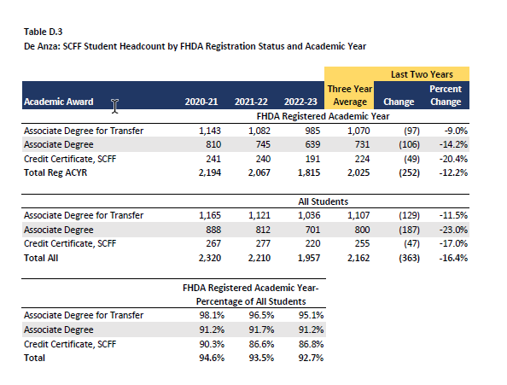
MIS SP submission reports (cont.)
Notes:
Some of the tables shown in the MIS SP submission report provides related SCFF (Student Centered Funding Formula) statistics. For example, in this table the data shows how students’ registration at the district level during the reporting academic year influences their headcount status (whether the student is included in the final headcount).

Slide 19
MIS SP submission reports (cont.)
Notes:
Student Headcount by Program keeps track of headcount by program, including data from resubmissions during the year. It also provides a copy of the MIS report for the original submission and resubmission.

