Slide 1
Mis Student Success
data sources and headcount figures 2013-14
Lourdes del Rio-Parent, PhD
Office of Institutional Research & Planning
Foothill-De Anza CCD

Slide 2
Presentation Goals
Data users will…
Acknowledge their pivotal role in the data validation process/clean-up.
Identify sources within data systems (e.g., Banner, SARS, Degree Works, Clockworks) used to report data on SS core services.
Identify and address discrepancies in data figures (actual versus expected headcount figures).
Understand the need for proper (i.e., auditable) documentation of all SS services provided, so the data can be included in the report.
Understand that validity is the degree of confidence one assigns to inferences and decisions made based on the data.
Notes:
1. Validity is an ongoing process that heavily depend on users feedback. Factors to take into include the (1) use of the data and (2) discrepancies between users’ expectations regarding headcounts and actual figures.

Slide 3
Validation of the MIS SS Report
As with any other measurement tool, the report needs to be validated (calibrated).
Beyond measuring change, data validation helps us assess whether our interpretations of the results are appropriate or meaningful (support the decision making-process).
Users have a pivotal role in the validation process for they gather and make decisions based on the data.
Notes:
Degree of confidence requires user involvement

Slide 4
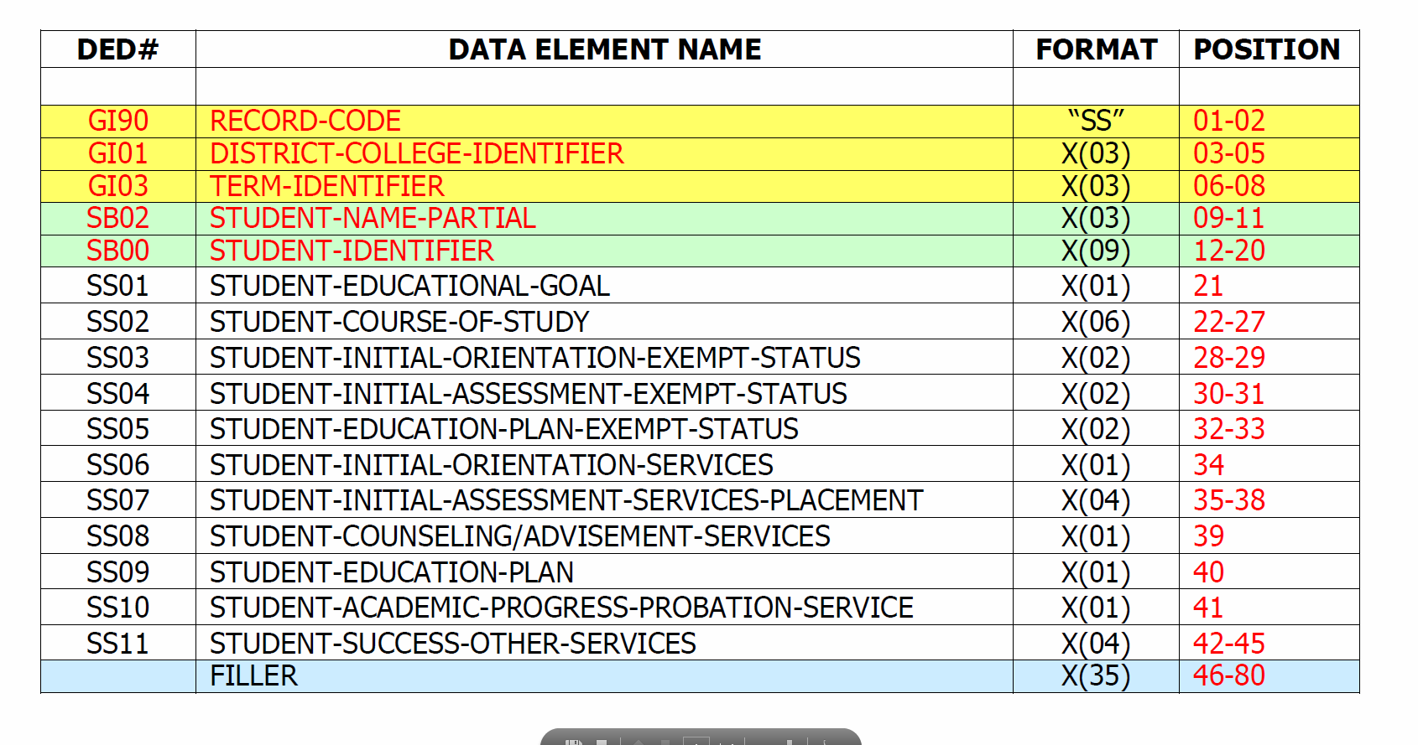
Invoice #____
MIS SS Report Domain
1. Who provided the service?
2. When was the service provided?
3. Who received the service?
4. What service was provided?

Slide 5
Student Success and Support Program Funding Guidelines, Chapter 4

Slide 6
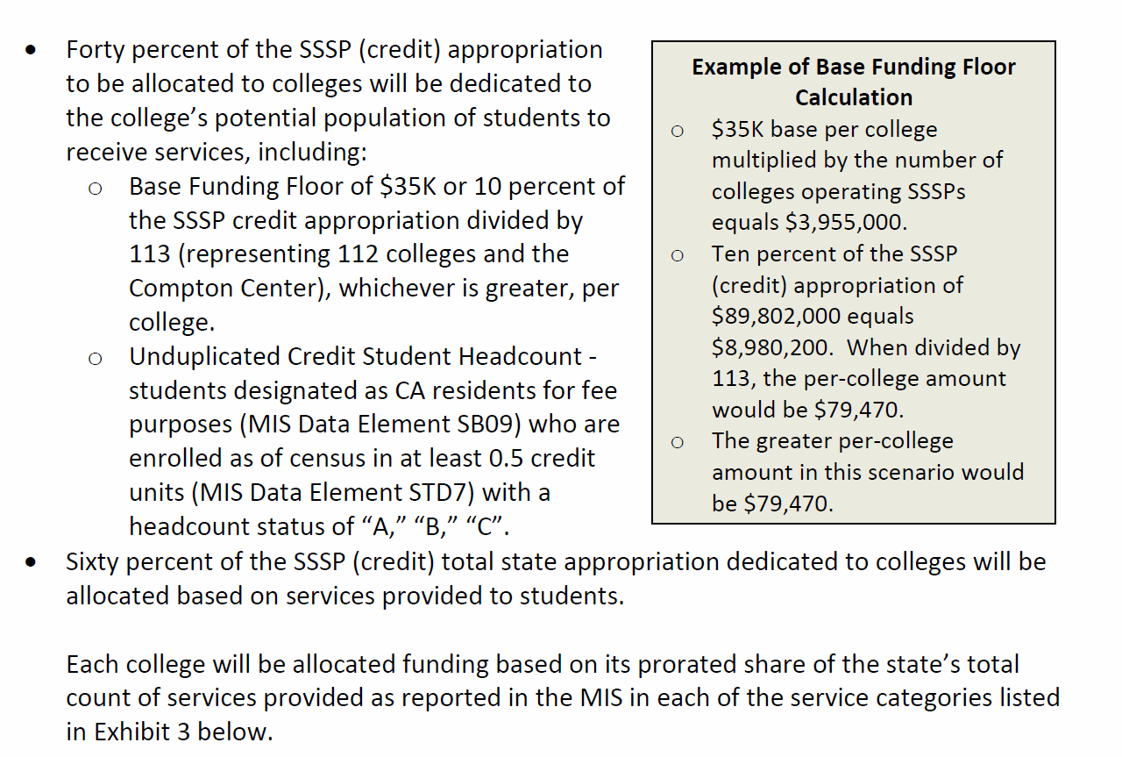
Student Success and Support Program Funding Guidelines, Chapter 4

Slide 7
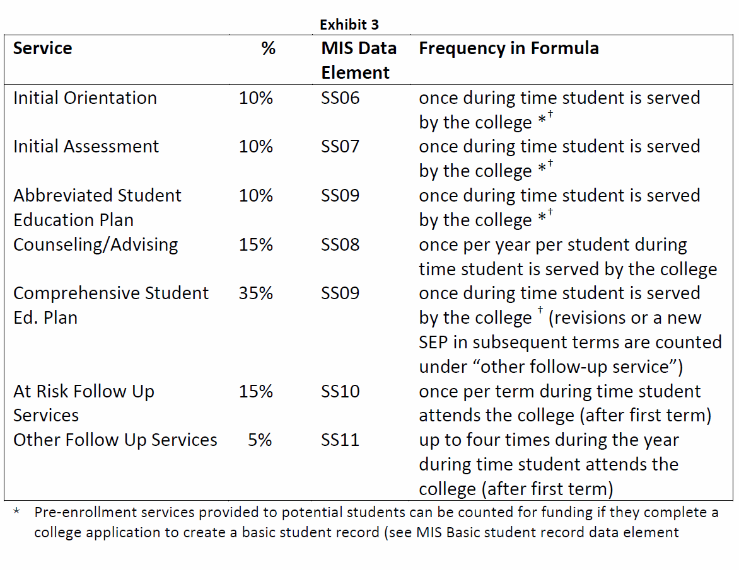
Student Success and Support Program Funding Guidelines, Chapter 4

Slide 8
Student Success Core Services and Related MIS Data Elements
Service | Service Type | MIS Data Element
1. Orientation | Initial & Follow-up | SS06; SS11 P1
2. Assessment | Initial & Follow-up | SS07; SS11 P2
3. Education Plan Development | Abbreviated, Comprehensive, Follow-up | SS09; SS11 P3
4.Counseling/Advising | Annual/Follow-up | SS08; SS11 P4
5. At Risk | Follow-up | SS10

Slide 9
Student Success Core Services and Related MIS Data Elements, and Data Sources
Orientation, Initial and Follow-Up
Initial or first substantive orientation—SS06
Follow-up orientation—SS11 Position 1
Data sources:
Course enrollment during the reporting term; Foothill: CNSL005; De Anza: COUN200, COUN200X, P E 070A, and P E 099.
Participation in program that provides orientation: Foothill: Pass the Torch; De Anza: Puente, Sankofa, Middle College, College Now
SARS—Based on location & ‘reason’ codes

Slide 10
Table 1
Student Headcount for Initial Orientation, SS06, and Follow-up, SS11 P1, by College and Data Source, 2013-14 Academic Year
 | Initial Orientation (SS06) |  | Follow-up Orientation (SS11 P1)
FHDA Data Source | Headcount | Percent | Headcount | Percent
Foothill
Orientation Course | 2,072 | 81% | 75 | 43%
Pass the Torch | 83 | 3% | 25 | 14%
Puente/Middle College | 77 | 3% | 0 | 0%
SARS | 486 | 19% | 78 | 45%
Prior Initial Orientation | - | - | 174 | 100%
Unduplicated Total | 2,558 | 100% | 174 | 100%
Document reference, page 5; figures are not mutually exclusive.

Slide 11
Table 1 (cont.)
Student Headcount for Initial Orientation, SS06, and Follow-up, SS11 P1, by College and Data Source, 2013-14 Academic Year
 | Initial Orientation (SS06) |  | Follow-up Orientation (SS11 P1)
FHDA Data Source | Headcount | Percent | Headcount | Percent
De Anza
Orientation Course | 4,469 | 82% | 196 | 78%
Puente/Sankofa/Middle College/College Now | 201 | 4% | 31 | 12%
SARS | 840 | 15% | 25 | 10%
Prior Initial Orientation | - | - | 252 | 100%
Unduplicated Total | 5,483 | 100% | 252 | 100%
Document reference, page 5; figures are not mutually exclusive.

Slide 12
Questions
Are we missing any data source that provides information on orientation services provided to students?
2. Do the headcount figures look reasonable?

Slide 13
Student Success Core Services and Related MIS Data Elements, and Data Sources
Assessment/Placement
Initial assessment/placement—SS07 (Positions 2 & 3)
Only related to English, Math, or ESL
Position 2 (at the reporting college)
Position 3 (at another institution)
Data sources:
Testing Office (SOATEST)
Test score for placement
Pre-requisite clearance
Program placement (e.g., Honors)
Transcript evaluation (SOAPCOL)
Registration override, first term (SFRSRPO)

Slide 14
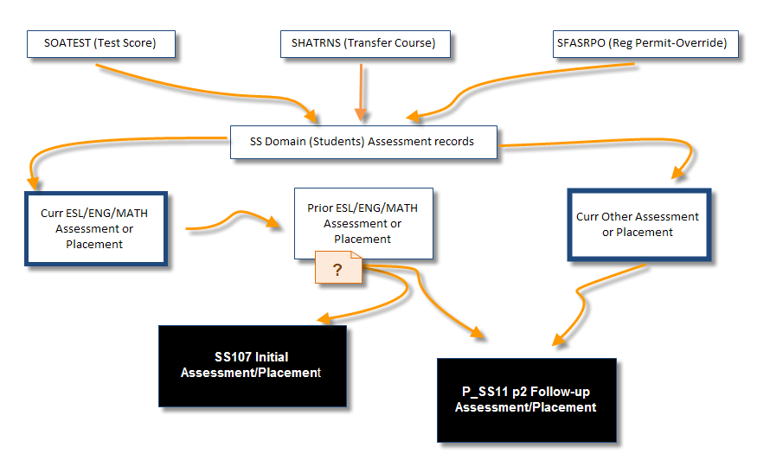
Testing for Initial Placement, SS07
No
Yes

Slide 15
Assessment/Placement (cont.)
2. Follow-up assessment/placement—SS11 P2
Follow-up to English, Math, or ESL placement
Initial or follow-up related to other course subjects
Career or interest assessments
Data sources
Same as initial placement SS07, when a prior assessment/placement is found
Multiple initial placements, SS07, during a follow-up term
SARS
Course enrollment

Slide 16
Assessment/Placement (cont.)
Courses that provide follow-up assessment services
Career planning;
Foothill: ALCB231. ALCB231X, ALCB231Y, ALCB231Z, CRLP055, CRLP070, CRLP070S, CRLP070T, CRLP071, CRLP072, CRLP073, CRLP074, GID 060, MUS 050C, and VART050
De Anza: APRN057A, AUTO057A, CLP 070, CLP 075, E S 095 and NURS050
Placement (DSPS)
Foothill: ALCA201
De Anza: GUID200, SPED240

Slide 17
Table 2
Student Headcount for Initial Assessment or Placement Services, Multiple Measures, SS07 P2, by College and Data Source, 2013-14 Academic Year
FHDA Data Source | Headcount | Percent
Foothill
Registration Override | 169 | 3%
Testing Office | 6,198 | 97%
Transcript/Doc Evaluation | 141 | 2%
Unduplicated Total | 6,419 | 100%
Document reference, page 6; figures are not mutually exclusive.

Slide 18
Table 2 (cont.)
Student Headcount for Initial Assessment or Placement Services, Multiple Measures, SS07 P2, by College and Data Source, 2013-14 Academic Year
FHDA Data Source | Headcount | Percent
De Anza
Registration Override | 2,497 | 23%
Testing Office | 8,608 | 79%
Transcript/Doc Evaluation | 136 | 1%
Unduplicated Total | 10,950 | 100%
Document reference, page 6; figures are not mutually exclusive.

Slide 19
Table 3
Student Headcount for Initial Assessment or Placement Services Based on Documentation from Another College, SS07 P3, by College and Data Source, 2013-14 Academic Year
FHDA Data Source | Headcount | Percent
Foothill
Testing Office | 201 | 55%
Transcript/Doc Evaluation | 164 | 45%
Unduplicated Total | 365 | 100%
Document reference, page 7; figures are not mutually exclusive.

Slide 20
Table 3 (cont.)
Student Headcount for Initial Assessment or Placement Services Based on Documentation from Another College, SS07 P3, by College and Data Source, 2013-14 Academic Year
FHDA Data Source | Headcount | Percent
De Anza
Transcript/Doc Evaluation | 843 | 100%
Unduplicated Total | 843 | 100%
Document reference, page 7; figures are not mutually exclusive.

Slide 21
Table 4
Student Headcount for Follow-up Assessment or Placement, SS11 P2, by College, 2013-14 Academic Year
FHDA Data Source | Headcount | Percent
Foothill
Course | 526 | 7%
Multiple Initial Assess/Placement | 2,314 | 32%
Prior Term Initial Assess/Placement | 1,200 | 17%
Registration Override | 1,305 | 18%
SARS | 2,105 | 29%
Testing Office | 4,284 | 59%
Transcript/Doc Evaluation | 529 | 7%
Unduplicated Total | 7,213 | 100%
Document reference, page 8; figures are not mutually exclusive.

Slide 22
Table 4 (cont.)
Student Headcount for Follow-up Assessment or Placement, SS11 P2, by College, 2013-14 Academic Year
FHDA Data Source | Headcount | Percent
De Anza
Course | 1,147 | 16%
Multiple Initial Assess/Placement | 2,934 | 41%
Prior Term Initial Assess/Placement | 2,019 | 28%
Registration Override | 2,136 | 30%
SARS | 2,481 | 35%
Testing Office | 1,156 | 16%
Transcript/Doc Evaluation | 1,531 | 21%
Unduplicated Total | 7,138 | 100%
Document reference, page 10; figures are not mutually exclusive.

Slide 23
Questions
Are we missing any data source that provides information on assessment/placement services provided to students?
2. Do the headcount figures look reasonable?

Slide 24
Student Success Core Services and Related MIS Data Elements, and Data Sources
Education Plan Development
FHDA operational definition: Education plan in Degree Works
Abbreviated, less than 3 terms
Comprehensive, 3 or more terms
Initial plan (comprehensive & abbreviated) reported in SS09; follow-up, SS11 P3

Slide 25
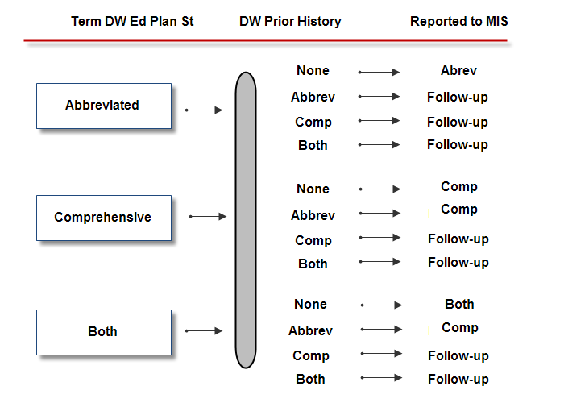
Processing Degree Works Data for MIS Reporting, SS09

Slide 26
Table 5
Student Headcount for Education Plan Development by Plan Type Developed in Degree Works and Reported in MIS, SS09, by College, 2013-14 Academic Year
Degree Works Plan Type | MIS Reported Plan Type | Headcount | Percent
Foothill
Abbreviated | Abbreviated | 817 | 25%
Both | Abbreviated | 3 | 0%
Both | Both | 26 | 1%
Comprehensive | Abbreviated | 329 | 10%
Comprehensive | Comprehensive | 2,208 | 66%
 | Unduplicated Total | 3,322 | 100%
Document reference, page 10; figures are not mutually exclusive.

Slide 27
Table 5 (cont.)
Student Headcount for Education Plan Development by Plan Type Developed in Degree Works and Reported in MIS, SS09, by College, 2013-14 Academic Year
Degree Works Plan Type | MIS Reported Plan Type | Headcount | Percent
De Anza
Abbreviated | Abbreviated | 2,960 | 61%
Both | Abbreviated | 8 | 0%
Both | Both | 20 | 0%
Comprehensive | Abbreviated | 131 | 3%
Comprehensive | Comprehensive | 1,853 | 38%
 | Unduplicated Total | 4,889 | 100%
Document reference, page 10; figures are not mutually exclusive.

Slide 28
Table 6
Student Headcount for Follow-up to Education Plan Development, SS11 P3, by College and Data Source, 2013-14 Academic Year
FHDA Data Source | Headcount | Percent
Foothill
Degree Works | 1,041 | 66%
SARS | 1,277 | 81%
Unduplicated Total | 1,583 | 100%
FHDA Data Source | Headcount | Percent
De Anza
Degree Works | 797 | 42%
SARS | 1,671 | 88%
Unduplicated Total | 1,905 | 100%
Document reference, page 10; figures are not mutually exclusive.

Slide 29
Questions
Any question regarding how data for education plan development is gathered and processed for MIS reporting?
2. Do the headcount figures look reasonable?

Slide 30
Student Success Core Services and Related MIS Data Elements, and Data Sources
Counseling/Advisement
Annual service reported in SS08
Follow-up, SS11 P4
Data sources:
SARS
Counseling courses:
Foothill: CNSL001, CNSL050, CNSL051, CNSL052, CNSL053, CNSL072, CNSL085A, CNSL085H, CNSL086, CNSL087, CNSL088, CNSL089, CNSL090, CNSL090A, CNSL090B, CNSL090C, CNSL175, CNSL275, CNSL86LX, CNSL86LY, CNSL86LZ

Slide 31
Counseling/Advisement (cont.)
Data sources:
Counseling course:
De Anza:COUN080X, COUN080Y, COUN080Z, GUID202, HUMA010, HUMA020, HUMA050
Categorical program: EOPS, DSPS, CalWorks
Special program (at risk/special populations)
Foothill: Puente, Middle College, Pass the Torch
De Anza: Puente, Sankofa, Middle College, College Now, MPS, Summer Bridge, First Year Experience

Slide 32
Table 7
Student Headcount for Counseling/Advisement, SS08, and Follow-up Services, SS11 P4, by College, 2013-14 Academic Year
 | Counseling/Advisement (SS08) |  |  | Follow-up Services (SS11 P4)
FHDA Data Source | Headcount |  | Percent | Headcount | Percent
Foothill
CalWorks | 36 |  | 0% | 43 | 2%
Counseling Course | 334 |  | 4% | 351 | 12%
DSPS | 1,127 |  | 15% | 770 | 27%
EOPS | 275 |  | 4% | 393 | 14%
Pass the Torch Course | 62 |  | 1% | 93 | 3%
Puente/Middle College | 149 |  | 2% | 150 | 5%
SARS | 6,526 |  | 85% | 2,215 | 78%
Prior Counseling Service | - |  | - | 2,575 | 90%
Unduplicated Total | 7,714 |  | 100% | 2,848 | 100%
Document reference, page 11; figures are not mutually exclusive.

Slide 33
Table 7 (cont.)
Student Headcount for Counseling/Advisement, SS08, and Follow-up Services, SS11 P4, by College, 2013-14 Academic Year
FHDA Data Source | Headcount |  | Percent | Headcount |  | Percent
De Anza
CalWorks | 115 |  | 1% | 116 |  | 2%
Counseling Course | 1,171 |  | 8% | 579 |  | 9%
DSPS | 1,514 |  | 10% | 1,517 |  | 24%
EOPS | 453 |  | 3% | 663 |  | 11%
First Year Experience | 258 |  | 2% | 267 |  | 4%
MPS Course | 115 |  | 1% | 195 |  | 3%
Puente, Sankofa, Middle College, College Now | 304 |  | 2% | 278 |  | 4%
SARS | 11,602 |  | 80% | 4,452 |  | 71%
Summer Bridge | 167 |  | 1% | 110 |  | 2%
Prior Counseling Services | - |  | - | 5,851 |  | 93%
Unduplicated Total | 14,471 |  | 100% | 6,270 |  | 100%
Document reference, page 11; figures are not mutually exclusive.

Slide 34
Student Success Core Services and Related MIS Data Elements, and Data Sources
Academic Progress/Probation
Students who were on probation/disqualification the prior term and received services the reporting term—SS10
Data Sources:
Academic standing (SHATERM)
SARS

Slide 35
Table 8
Student Headcount for Academic Progress or Probation Service, SS10, by College, 2013-14 Academic Year
Prior Term Academic Standing | SARS Probation Services | SARS Counseling Services | MIS Reported SS10 Progress/Probation Services | Headcount | Percent
Foothill
Dismissal | No | Yes | Dismissal | 65 | 11%
Dismissal | Yes | No | Dismissal | 11 | 2%
Dismissal | Yes | Yes | Dismissal | 17 | 3%
Good Standing | Yes | No | Acad Prog/Prob | 185 | 31%
Good Standing | Yes | Yes | Acad Prog/Prob | 188 | 31%
Probation | No | Yes | Acad Prog/Prob | 172 | 29%
Probation | Yes | No | Acad Prog/Prob | 11 | 2%
Probation | Yes | Yes | Acad Prog/Prob | 19 | 3%
 |  |  | Unduplicated Total | 598 | 100%
Document reference, page 11; figures are not mutually exclusive.

Slide 36
Table 8
Student Headcount for Academic Progress or Probation Service, SS10, by College, 2013-14 Academic Year
Prior Term Academic Standing | SARS Probation Services | SARS Counseling Services | MIS Reported SS10 Progress/Probation Services |  | Headcount | Percent
De Anza
Dismissal | No | Yes | Dismissal |  | 101 | 9%
Dismissal | Yes | No | Dismissal |  | 83 | 8%
Dismissal | Yes | Yes | Dismissal |  | 152 | 14%
Good Standing | Yes | No | Acad Prog/Prob |  | 104 | 10%
Good Standing | Yes | Yes | Acad Prog/Prob |  | 351 | 33%
Probation | No | Yes | Acad Prog/Prob |  | 429 | 40%
Probation | Yes | No | Acad Prog/Prob |  | 22 | 2%
Probation | Yes | Yes | Acad Prog/Prob |  | 21 | 2%
 |  |  | Unduplicated Total |  | 1,073 | 100%
Document reference, page 11; figures are not mutually exclusive.

Slide 37
Questions
Any question regarding how data for academic probation services is gathered and process for MIS reporting?
2. Do the headcount figures look reasonable?

Slide 38
Conclusion
Validation
Contract between users and researchers/data analysts
Continuous process to assess the extent to which the data is meaningful and appropriate to reach a given set of conclusions
Main goal: to support…

