Slide 1
MIS Student success report
Review of Degree Works and SARS Systems
De Anza College, March 9 of 2016
Lourdes del Rio-Parent, PhD IR&P FHDA

Slide 2
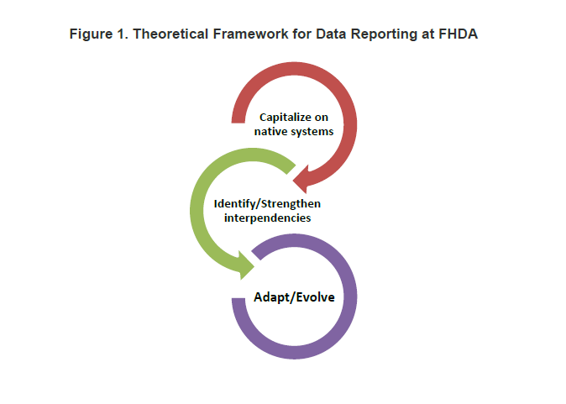
Reference, “MIS Student Success: Report Domain and Procedures”
Notes:
The term native system refers to a system already in placed that has been successfully adopted (or evolved) to meet the needs within the work setting. Identify/strengthen refers to analyzing work practices that may help or hinder the gathering of information. Adapt/Evolve refers to changes in work practices or technologies needed to improve the gathering and reporting of data.

Slide 3
Likely Native Systems: degree Works and SARS
Native System: System that has been successfully used to document the activities or services we need to report. Allows us to more efficiently gather and validate data for the report.
Degree Works: Degree audit system used by the College to document student education plan development.
Student ID
Terms or length of education plan (abbreviated, 1 or 2 terms; comprehensive, 3 or more terms)
Date when plan was developed or modified
SARS: Scheduling system used to schedule appointments across offices and departments at the College
Student ID
Purpose of the meeting
Date of the meeting (including whether the meeting was cancelled, attended)
Notes:
SARS and Degree Works have been in placed for some time at the College and have the data needed for MIS SS. However, the question is whether users have been using these systems in the most efficient way to reliable gather the data for the report.

Slide 4
Identify and strengthen interdependencies
The use of Degree Works (DW) to document student education plan development is dependent on:
Counselors/Advisors/Students:
Having an incentive to learn and frequently use DW (e.g., priority registration, facilitates tasks at work)
Knowing how to use DW (training, tutorials and reference material readily available and easy to use)
Using DW effectively (e.g., frequent use of DW to monitor and plan student progress)
Being aware how DW data is used for research and reporting
Notes:
Do we know to what degree each of these is true at De Anza College? Do we have evidence to support our answers?

Slide 5
Reporting SS09 Education Plan development
Title 5 § 55524. Student Educational Plan
(1) Abbreviated student education plans are one to two terms in length designed to meet the immediate needs of students for whom a comprehensive plan is not appropriate;
Comprehensive student education plans take into account a student’s interests, skills, career and education goals, major, potential transfer institutions, and the steps the student needs to take on their educational path to complete their identified course of study. The comprehensive plan helps the student achieve their course of study. The comprehensive plan includes, but is not limited to, addressing the education goal and course of study requirements, such as the requirements for the major, transfer, certificate, program, applicable course prerequisites or co-requisites, the need for basic skills, assessment for placement results, and the need for referral to other support and instructional services as appropriate. The comprehensive student education plan is tailored to meet the individual needs and interests of the student and may include other elements to satisfy participation requirements for programs such as EOPS, DSPS, CalWORKs, veterans education benefits, athletics, and others.

Slide 6
Reporting SS09 Education Plan development (cont.)
SS09 is intended to capture information on education plans as defined in Title5, Section 55524. Once an abbreviated and/or a comprehensive education plan is developed, revisions are reported in SS11 (STUDENT-SUCCESS-OTHER-SERVICES).
FHDA adopted operational definitions:
1 to 2 terms: abbreviated plan
3 or more terms: comprehensive plan
Only terms with at least one course will count
Does not need to be approved/locked or active

Slide 7
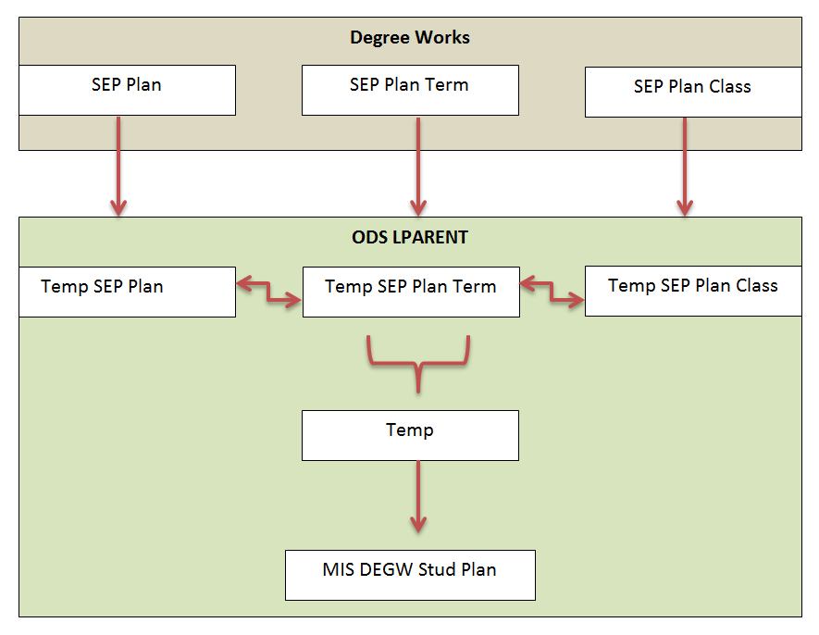

Slide 8
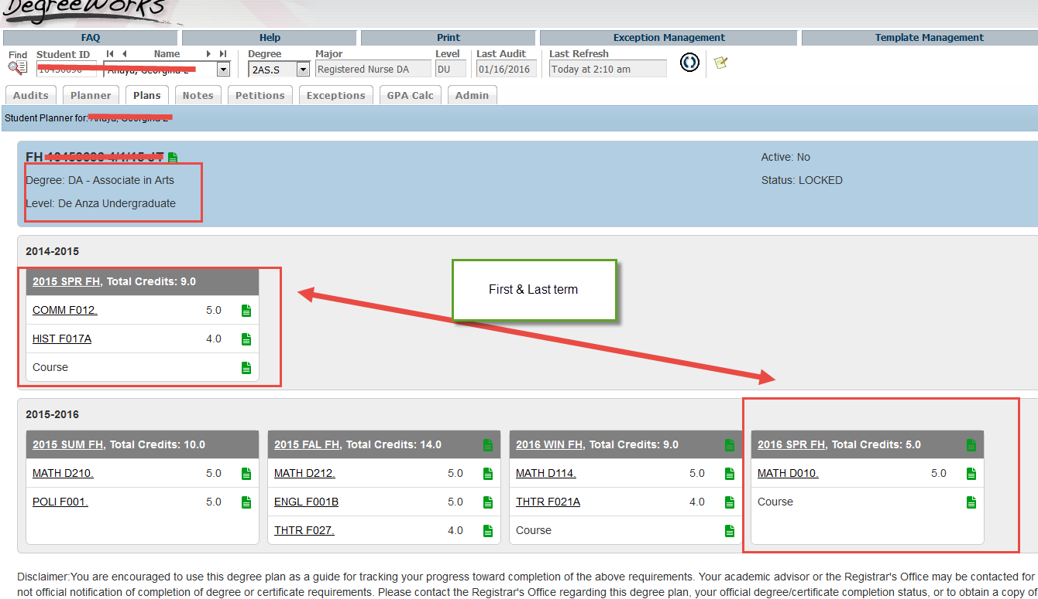
Edit meant to fix school code
Notes:
In the last table, MIS DEGW Stud Plan the school code is changed when the first and last term suggest that the education plan is for the other college.

Slide 9
Examples of education plans

Slide 10
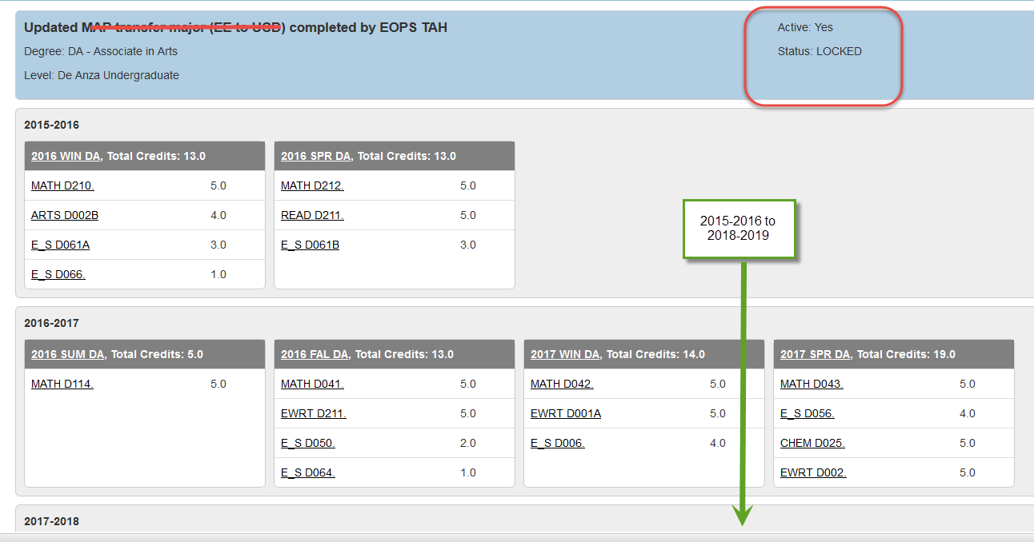
The Good
Notes:
More than a contract, the educational plan can be seen as a medical record: steps to promote a healthy education experience. Developing the ed plan may be one of those few opportunities students have to talk to an expert about not just academics, but also about personal factors that may trigger referral to other services such as financial aid, tutoring, of DSPS services.

Slide 11
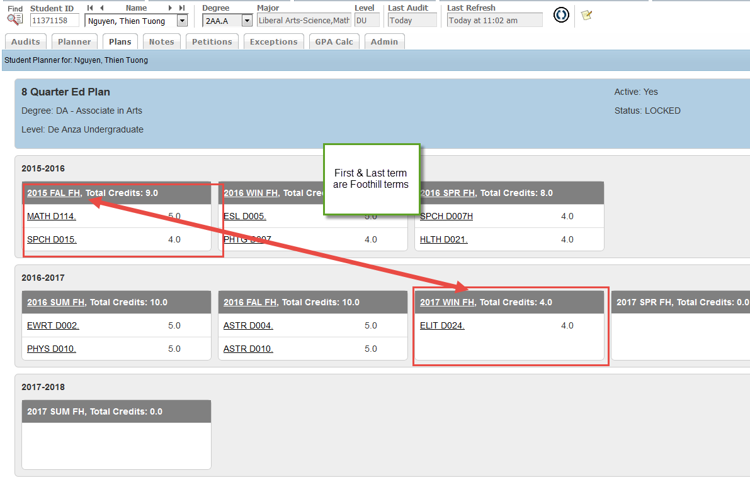
The bad
Notes:
Because the first and last term are Foothill College, the school code will be changed to ‘FU.’ The plan will not be reported for De Anza.

Slide 12
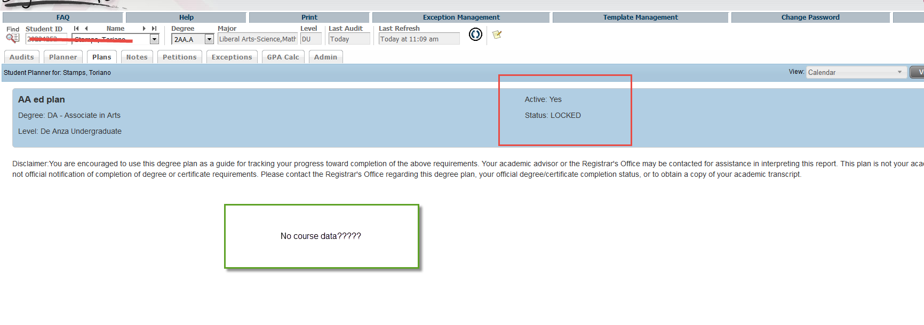
The ugly
Notes:
This record is not included or reported to MIS. No impact.

Slide 13
Identify and strengthen interdependencies
SARS is used to document orientation (SS06), counseling (SS08), and academic probation (SS10) and follow-up services (SS11: orientation, assessment, education plan, other follow-up services)
Use of this system is dependent on counselors, advisors, or assistants:
Having an incentive or motivation to learn and effectively use SARS (e.g., facilitates tasks at work)
Knowing how to use SARS (training, tutorials, reference material readily available on what each reason code means, when should be used)
Using SARS effectively (e.g., properly documenting reasons for meeting)
Notes:
Do we know to what degree each of these is true at De Anza College? Do we have evidence to support our answers?

Slide 14
Content review of SARS codes
For a given location using SARS (e.g., Counseling, EOPS Office, Athletics), are all 3SP related services provided at the location covered by the reason codes in SARS? To what extent do users agree on the crosswalk between reason codes for the location and MIS SS codes/services? (See IRP-MIS-SS website for lookup table.)
Are all users motivated to use SARS reason codes to document the services provided at the location?
Do all users agree on the “meaning” for each of the reason codes used at the location? (User know what each reason code means.)
Are the SARS reasons codes being used correctly and efficiently to document services at the location?

Slide 15
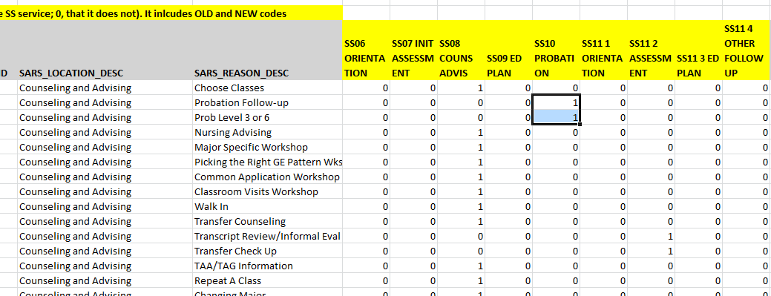
SARS Reason codes-MIS SS crosswalk

Slide 16
Questions
Can Degree Works or SARS be classified as a “native system” at the De Anza College that can effectively be used for the MIS SS data report?
Can we strengthen interdependencies between users and these systems?
Should we evolve, adapt or change these systems, or our work practices?

